Slide 1
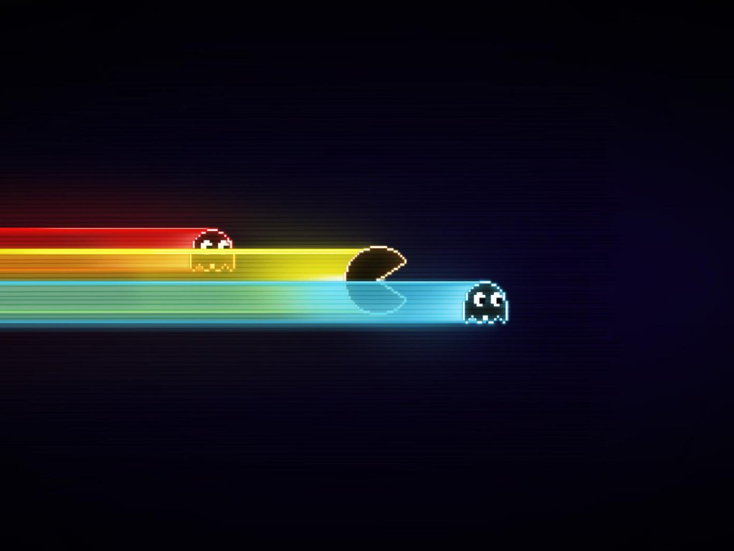
What makes a game fun
Introduction to game design
Jean-Baptiste Boin

Slide 2
What we won’t discuss today
Many elements are needed to make a great game
Story
Artwork
Genre
We will mainly focus on the gameplay in general

Slide 3
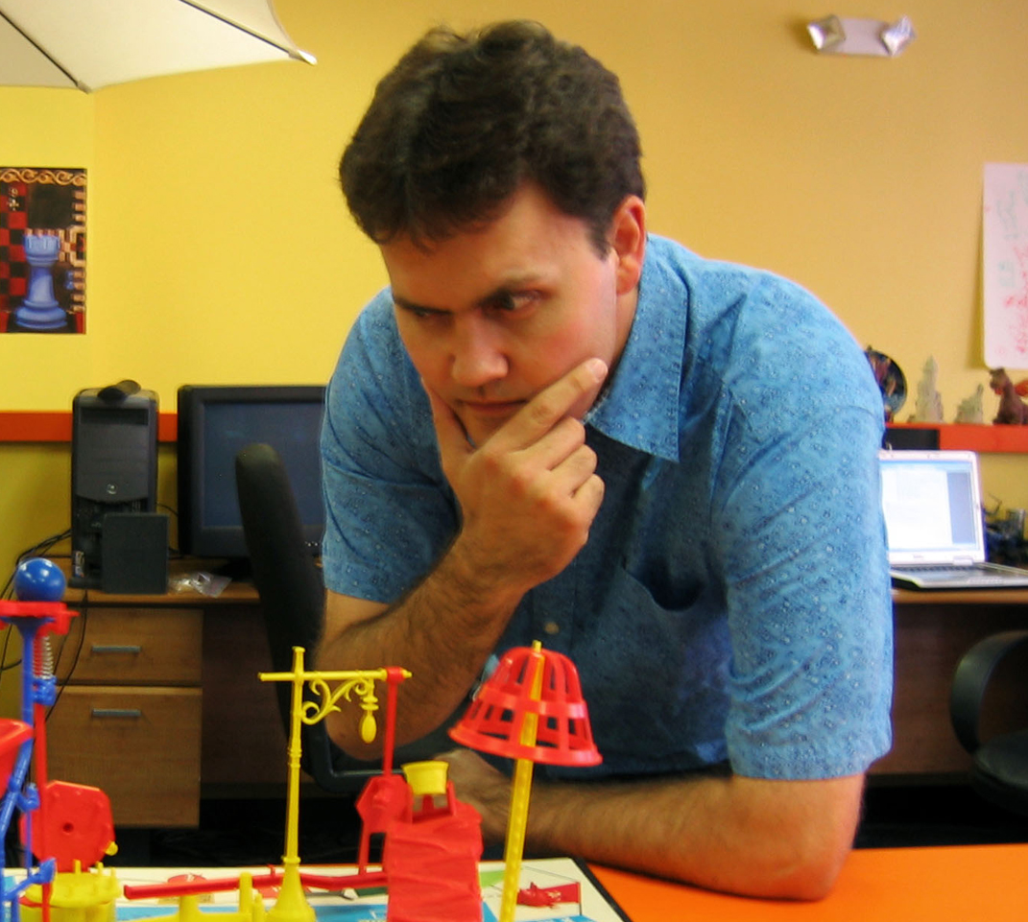
What is a game?
A game ≠ a toy problem solving
A game ≠ work playful attitude
“A game is a problem solving activity, approached with a playful attitude”
(Jesse Schell)

Slide 4
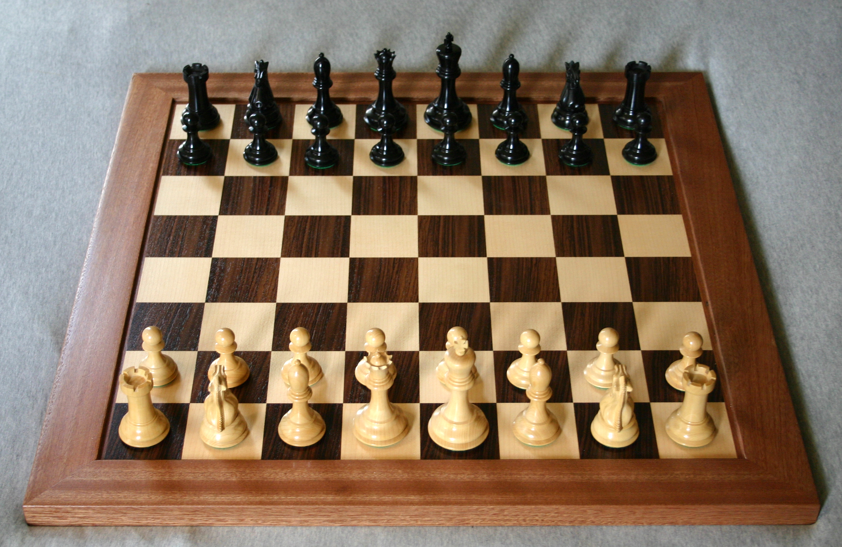
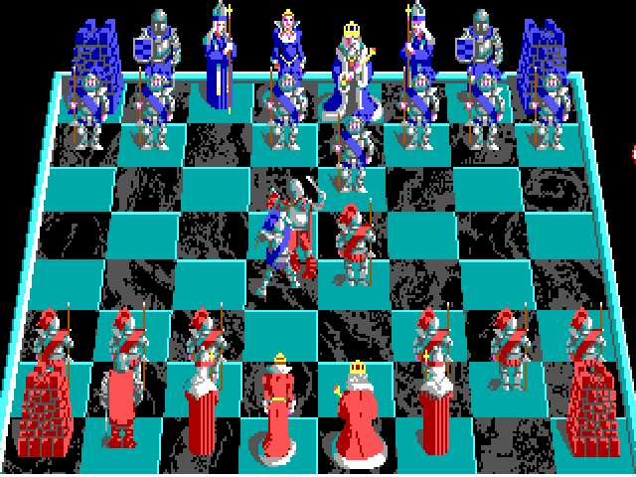
A set of rules
Game designer: creates/organizes these rules
Board games vs. computer games
Battlechess (Amiga), 1988
Notes:
the computer can teach you the rules (ex. of a game of chess with and without a computer, or any other complicated game for that matter)
you don't need to be aware of all the rules (ex. playing civilization on a board game would be hell)
3. a good design introduces mechanics in a smart way, cf. an example of GREAT game design in Mario

Slide 5
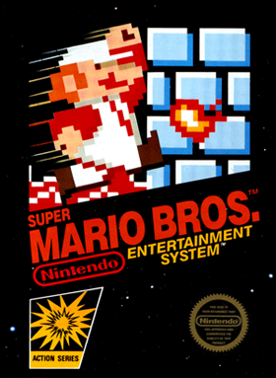
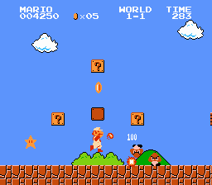
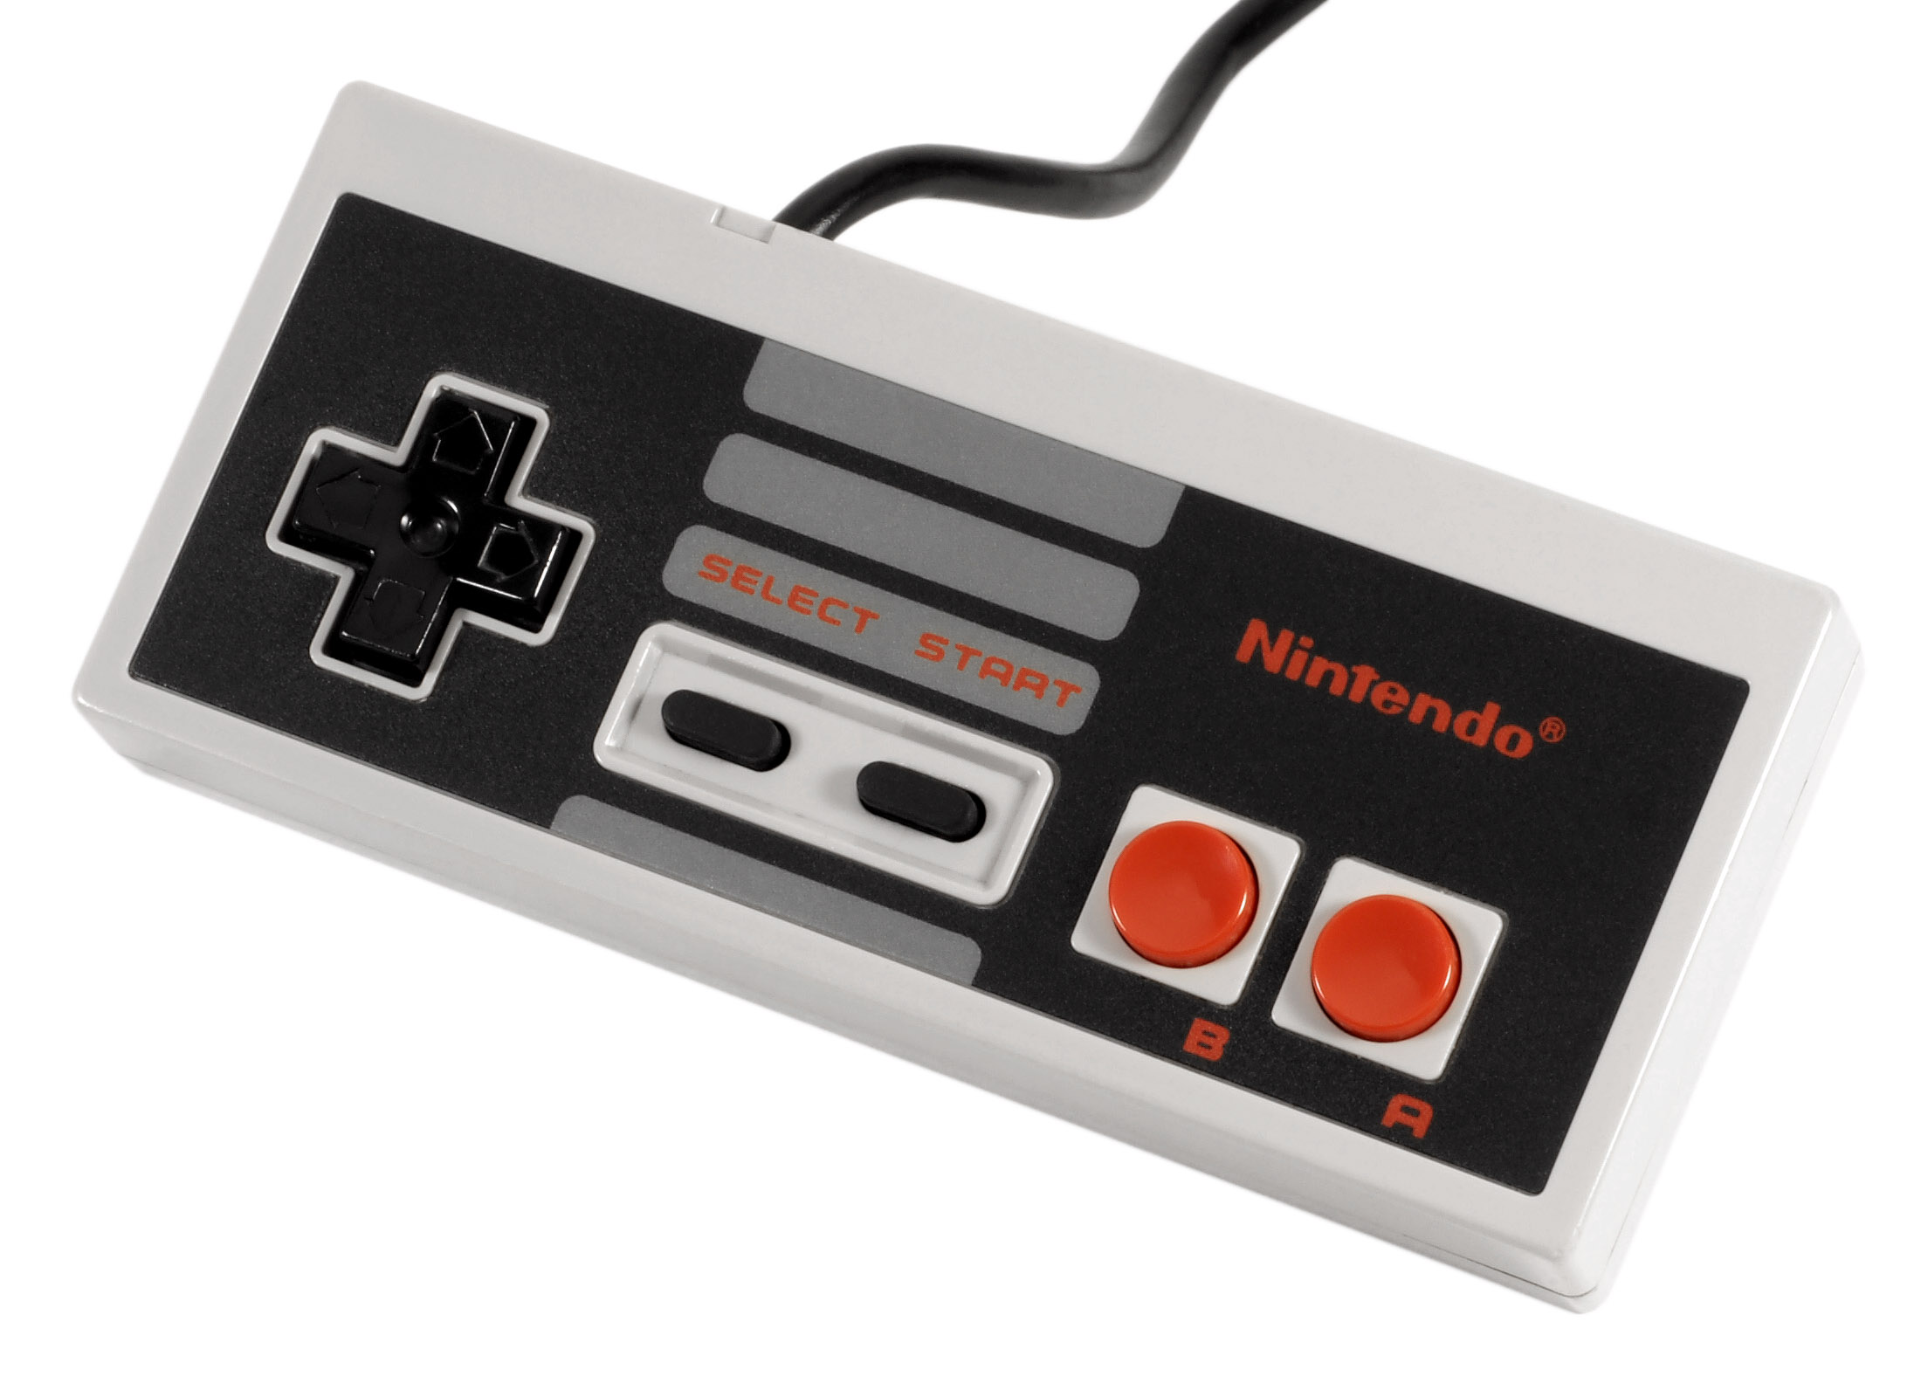
Case study: Super Mario Bros. (lvl 1)
Released in 1985 on NES
Sold 40.24 million copies (fourth best-selling game ever)
Notes:
Tetris (143 million)
Wii Sports (81.99 m)
Minecraft (48.8 m)

Slide 6
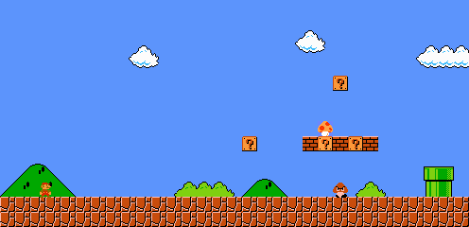
Case study: Super Mario Bros. (lvl 1)
Nice article: http://auntiepixelante.com/?p=465
Notes:
Tetris (143 million)
Wii Sports (81.99 m)
Minecraft (48.8 m)

Slide 7
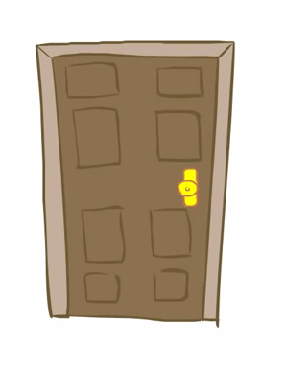
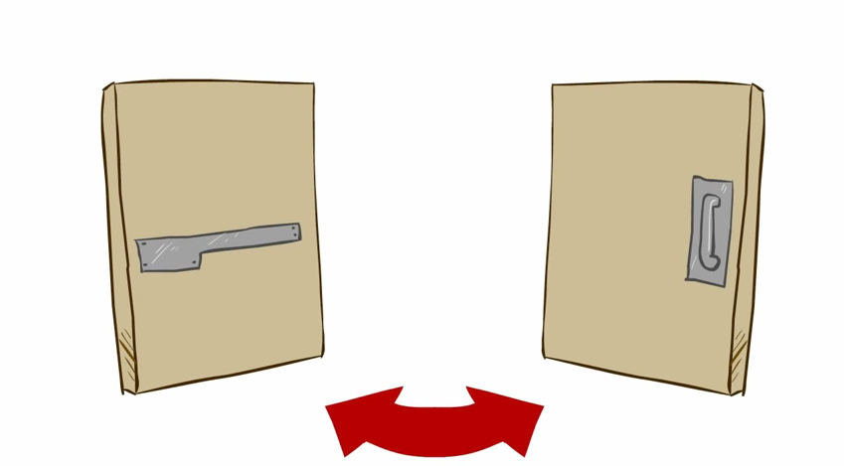
Affordance

Slide 8
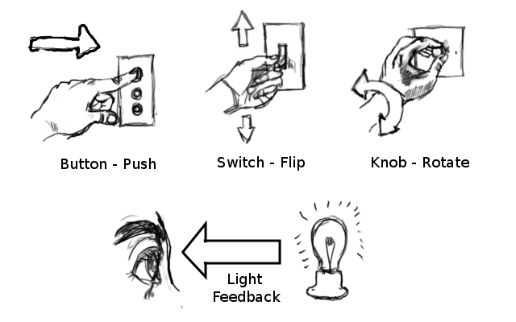
Affordance
Concept coming from the design world (The Design of Everyday Things, Donald Norman)
Making things “obvious” to use

Slide 9
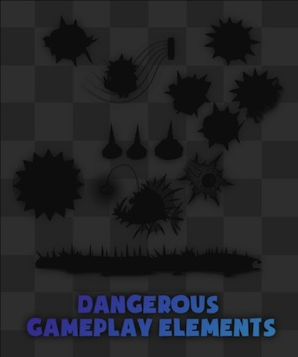
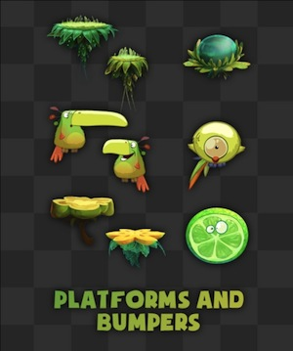
Affordance
Rayman Origins (PS3, Xbox360, Wii), 2010

Slide 10
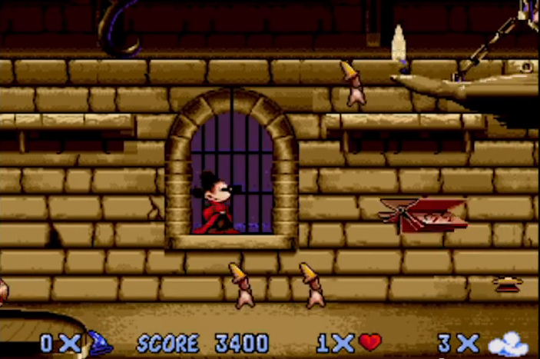
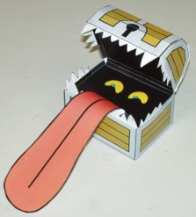
Affordance
Fantasia (Mega Drive), 1991

Slide 11
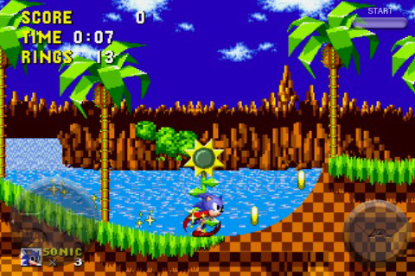
Core mechanics
One core gameplay
Super Mario Bros. (NES), 1985
Sonic the Hedgehog (Mega Drive), 1991

Slide 12
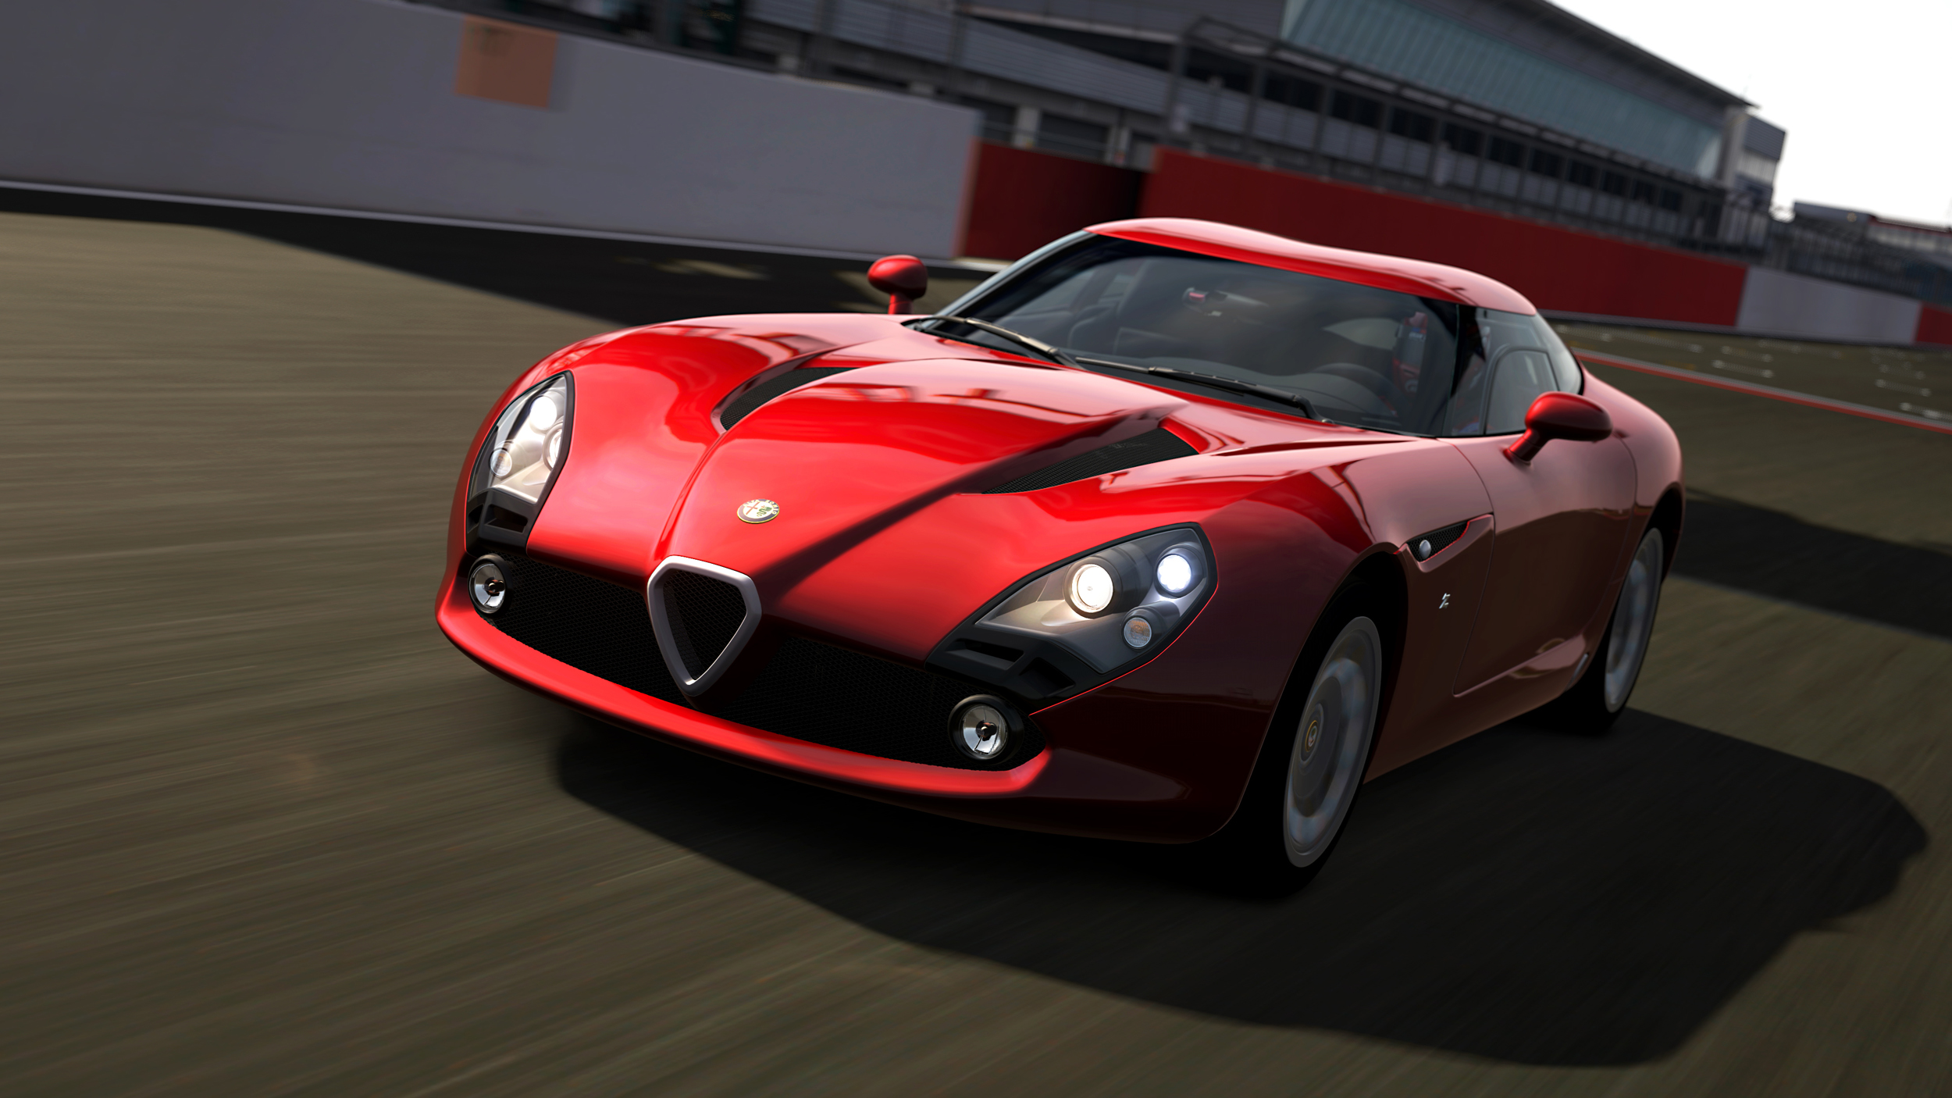
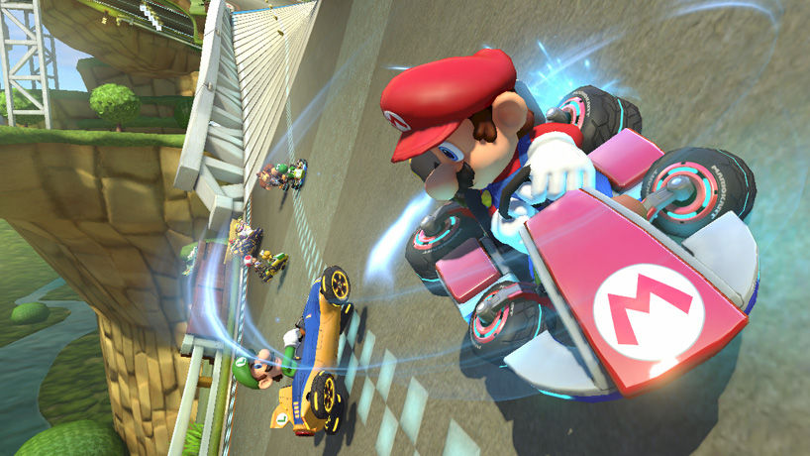
Core mechanics
One core gameplay
Gran Turismo 6 (PS3), 2013
Mario Kart 8 (Wii U), 2014

Slide 13
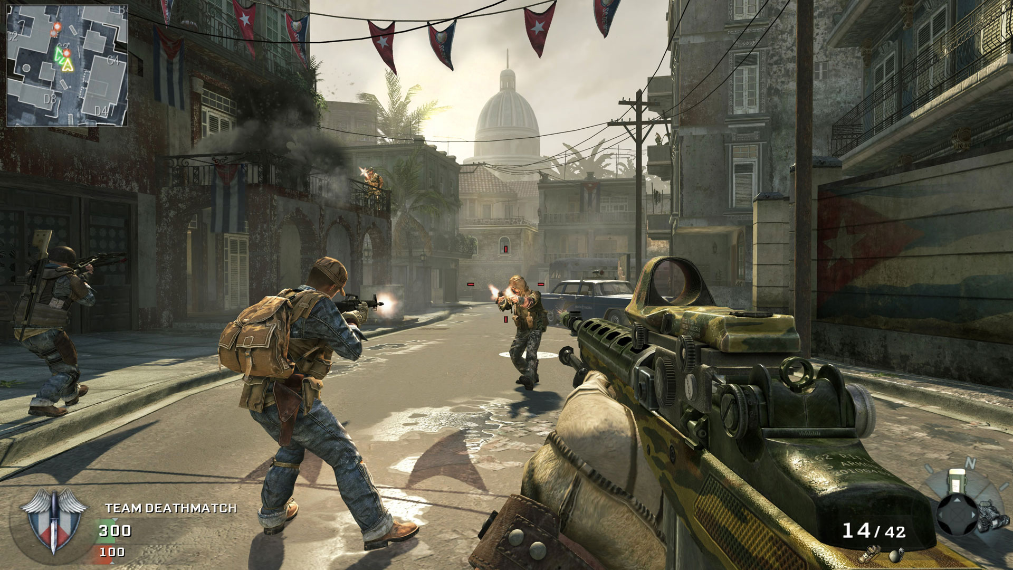
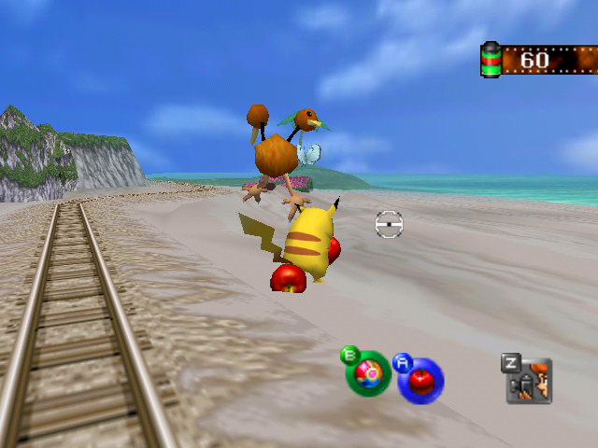
Core mechanics
One core gameplay
Call of Duty: Black Ops
(Xbox 360, PS3, Wii, Windows, Mac), 2010
Pokemon Snap (Nintendo 64), 1999

Slide 14
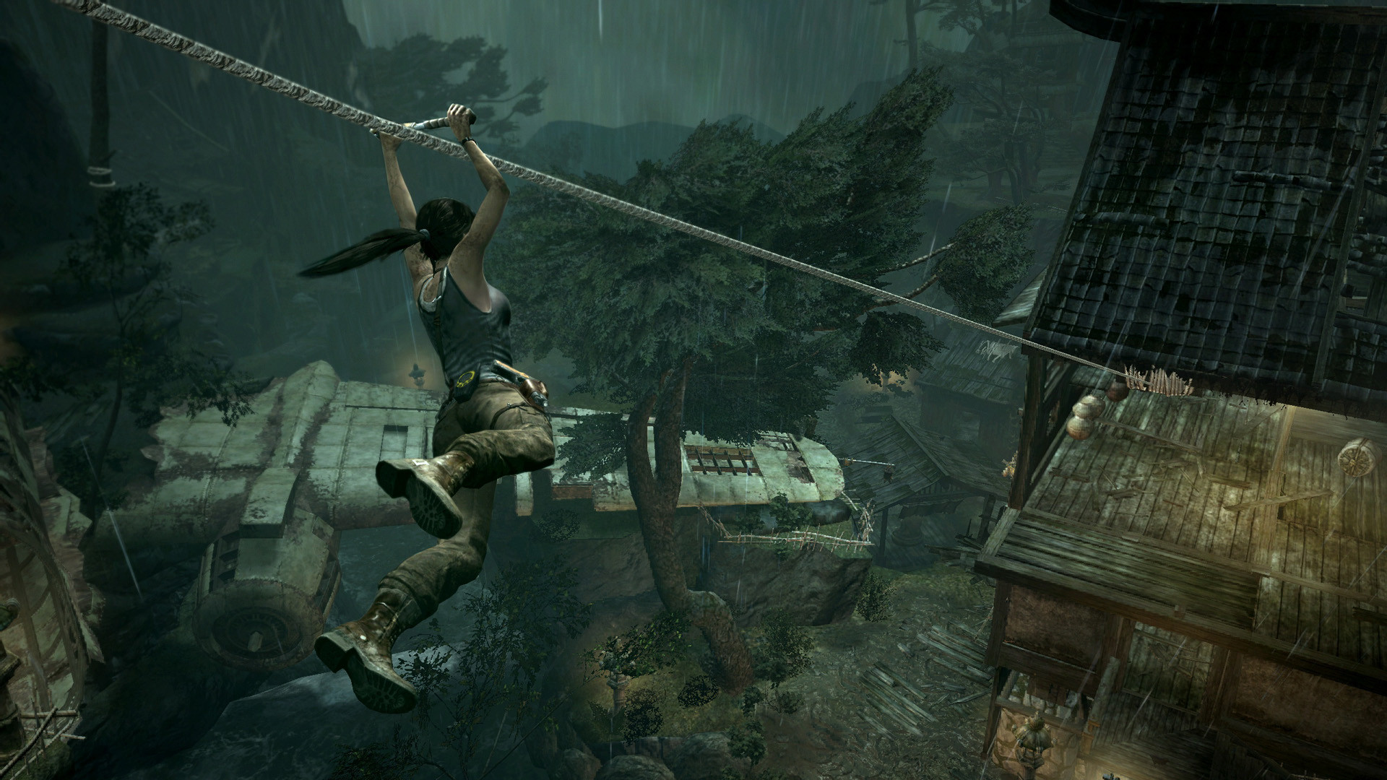
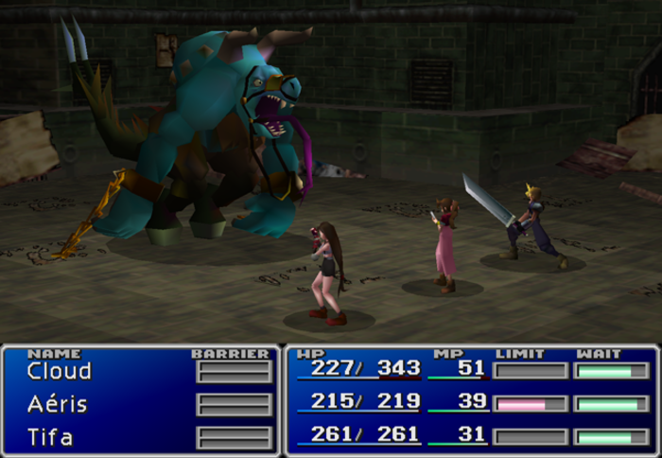
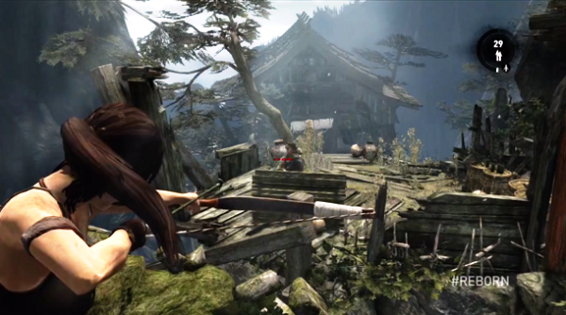
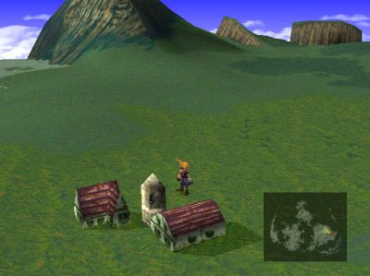
Core mechanics
Dual-core
Tomb Raider (Windows, Mac, PS3, Xbox360), 2013
Final Fantasy VII (PS), 1997

Slide 15
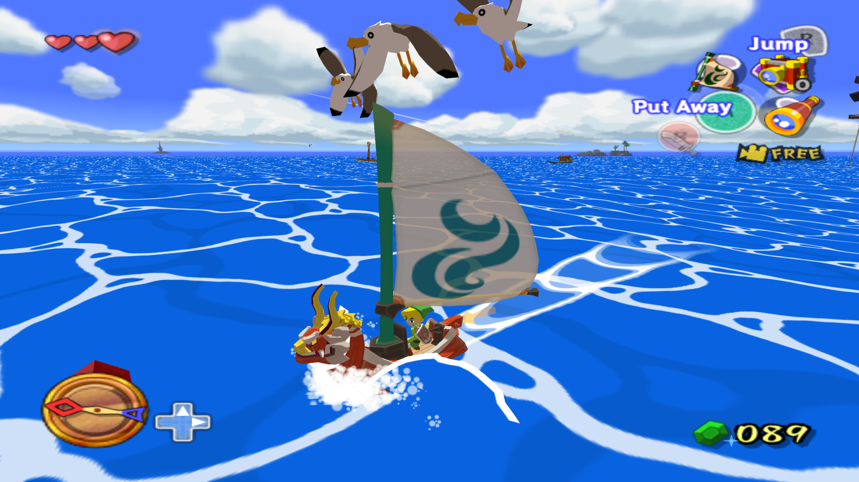
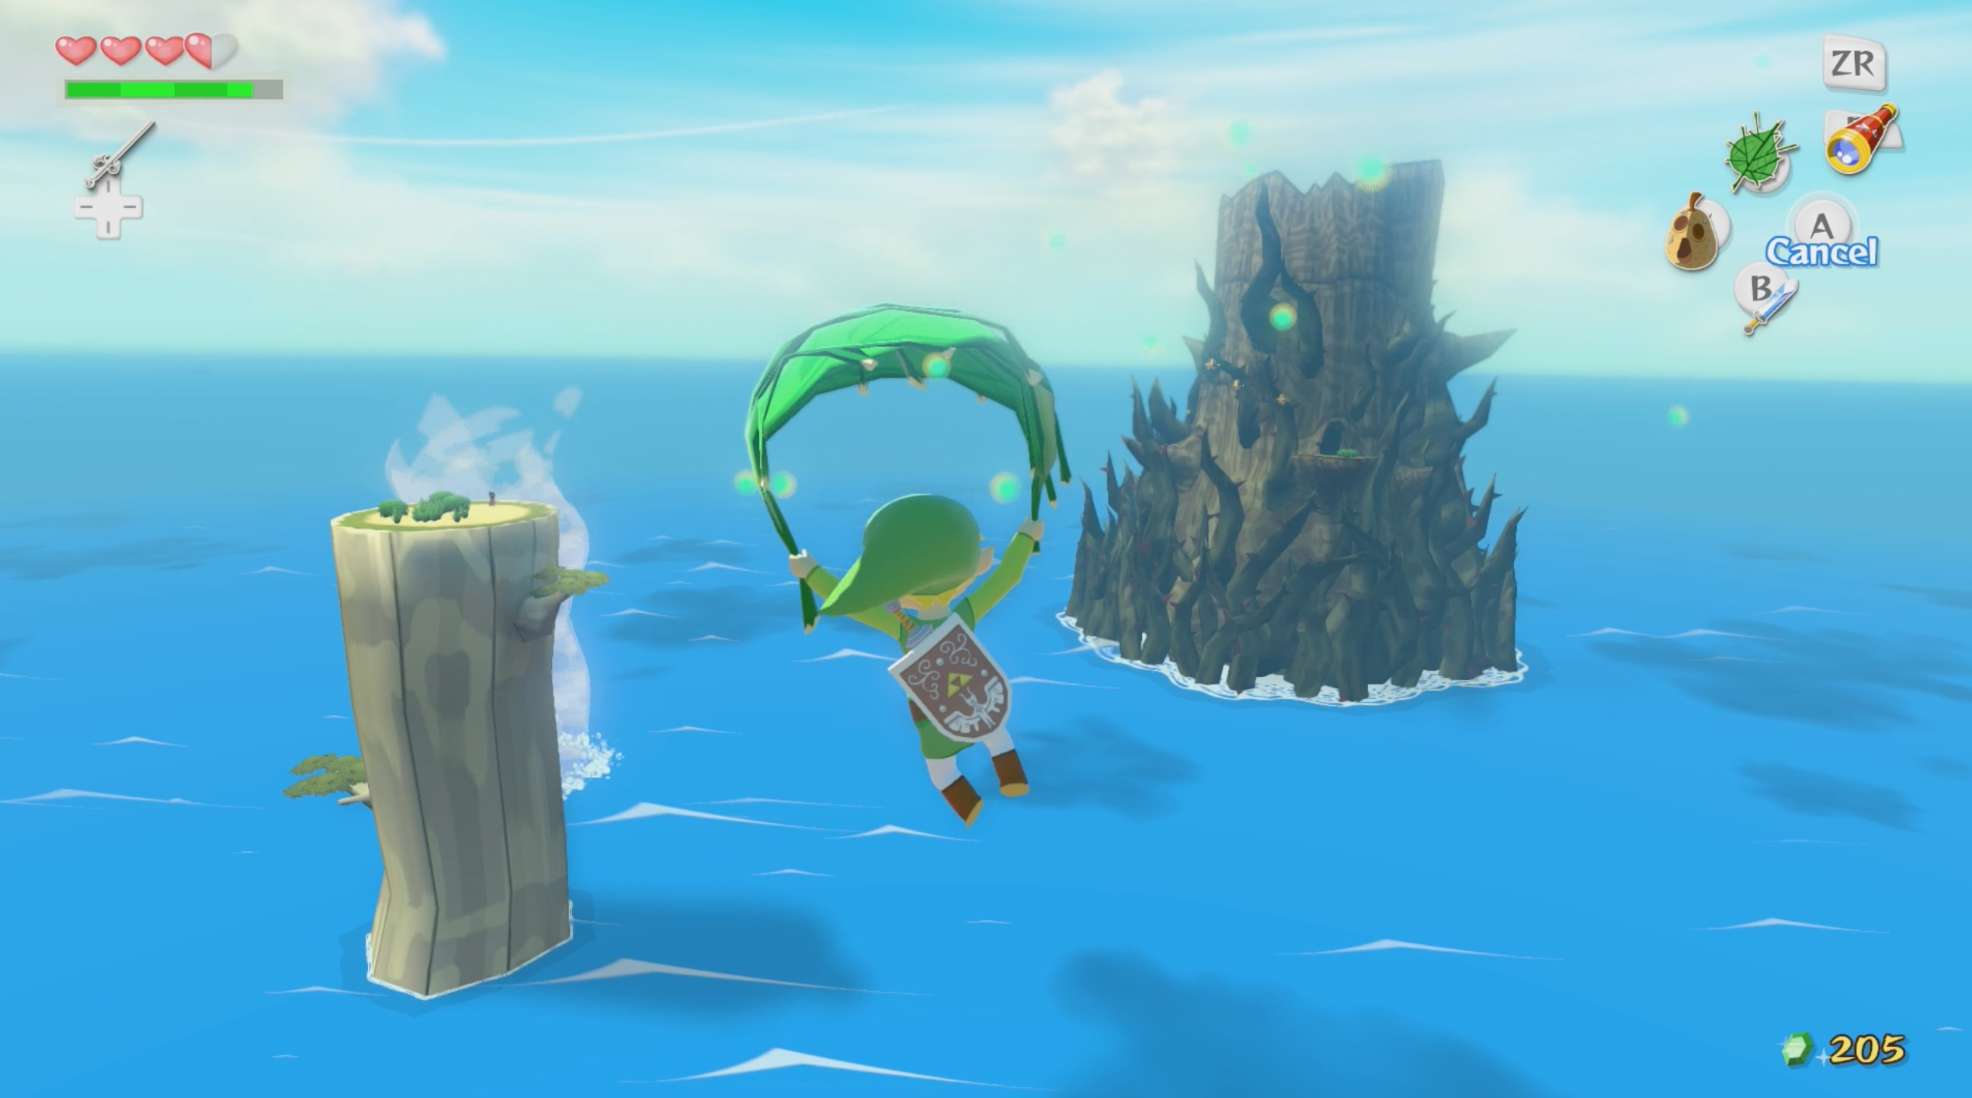
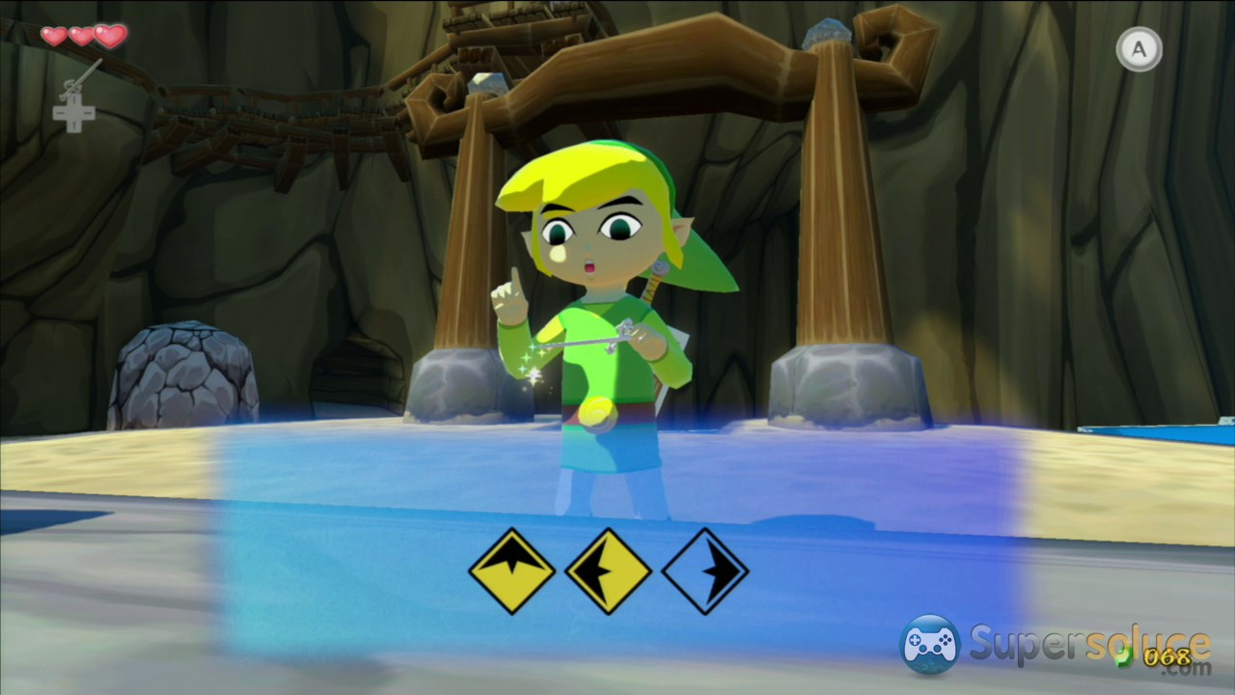
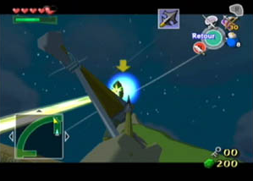
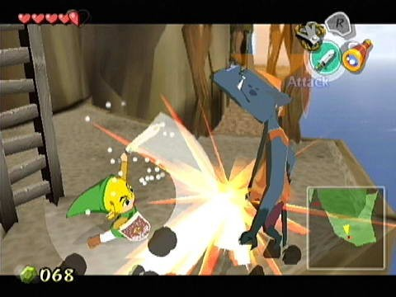
Core mechanics
Multi-core
The Legend of Zelda: The Wind Waker (GameCube), 2002

Slide 16
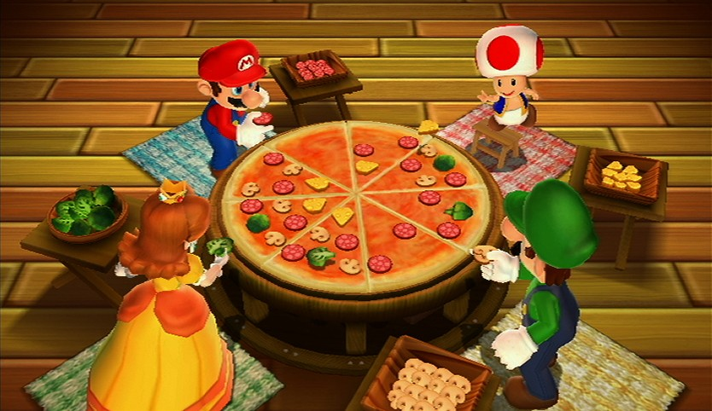
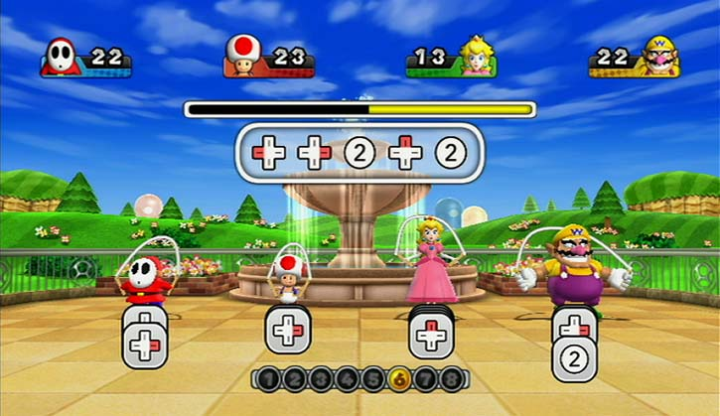
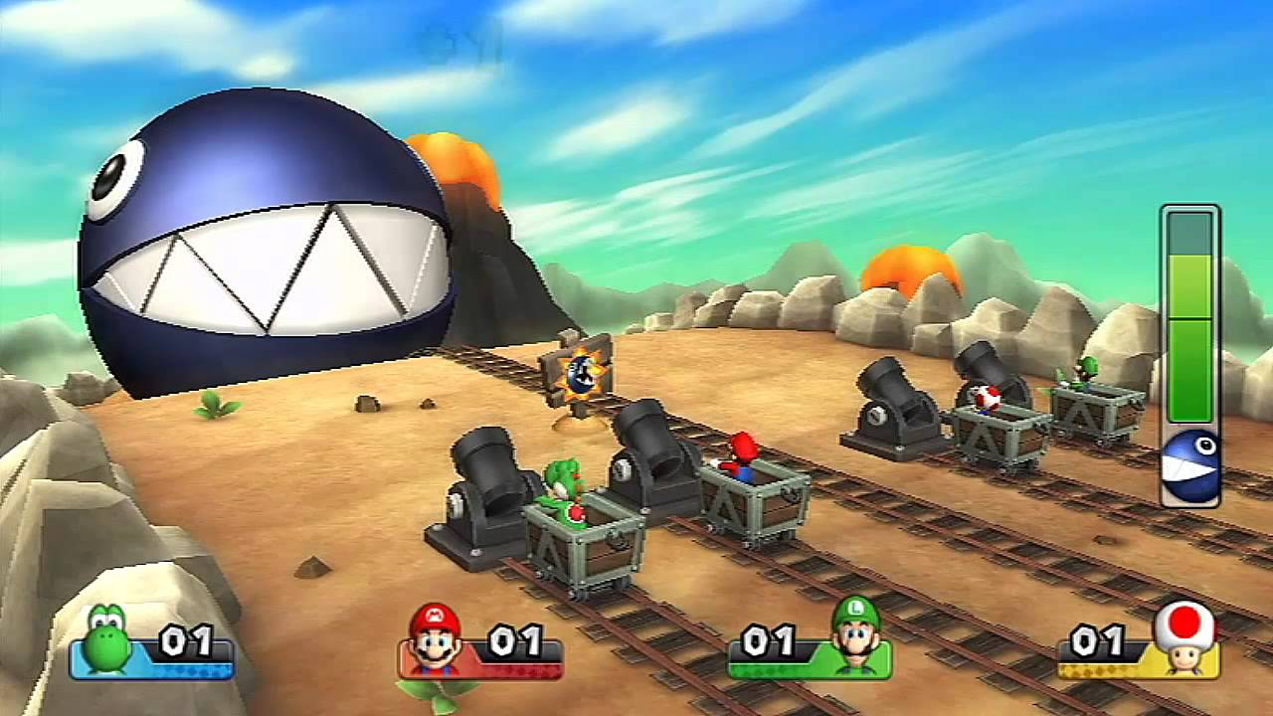
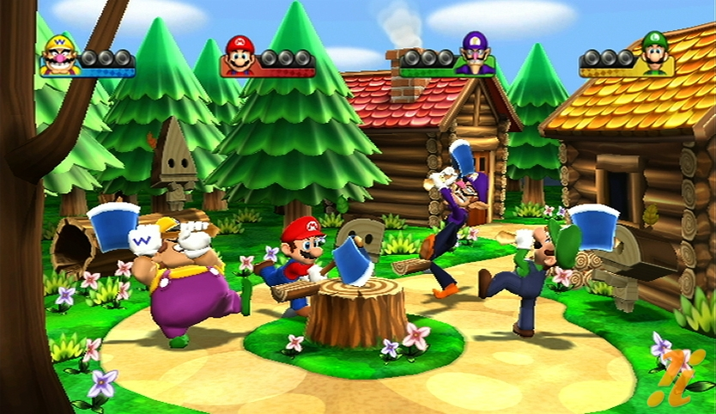
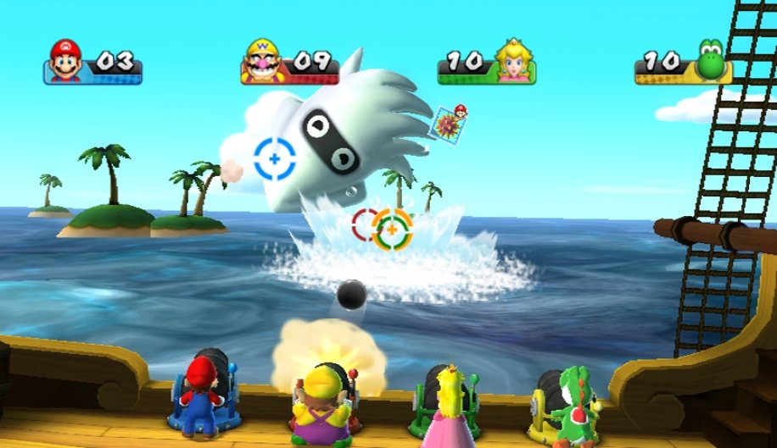
Core mechanics
“Many”-core
Mario Party 9 (Wii), 2012

Slide 17
Gameplay loops
Micro
Medium
Macro
The Legend of Zelda: Skyward Sword (Wii), 2011

Slide 18
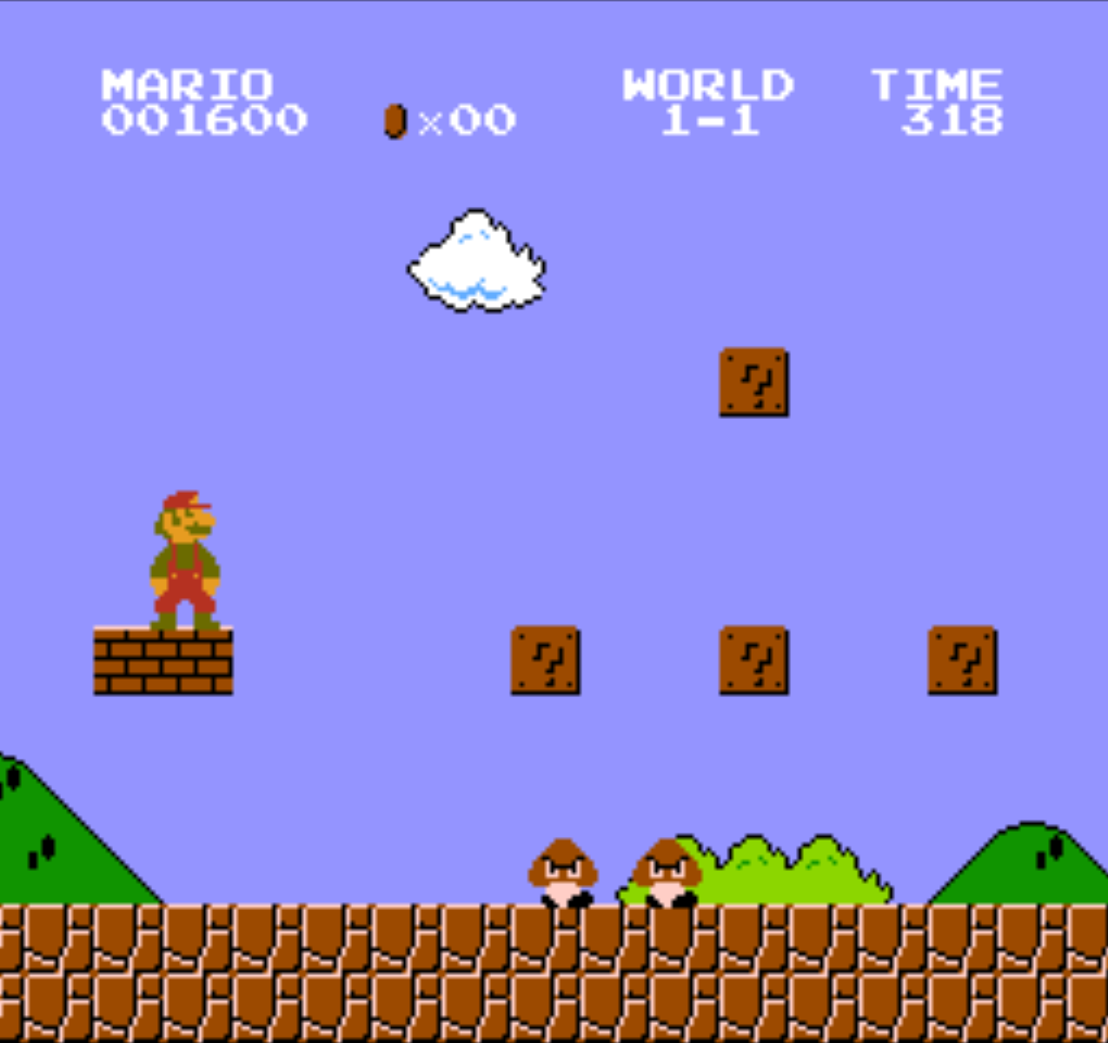
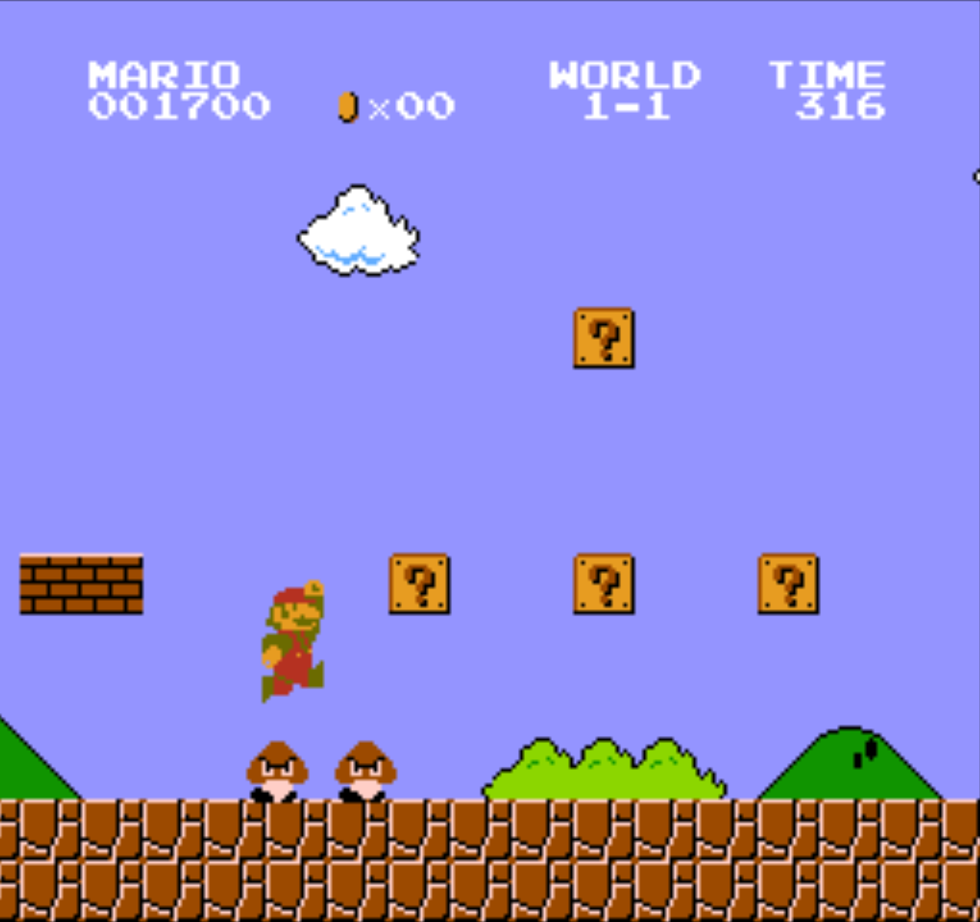
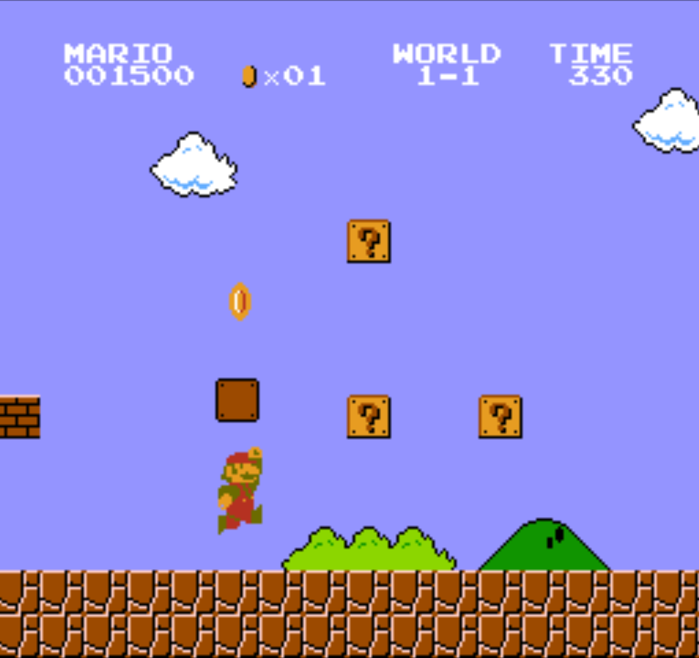
Gameplay loops
Objective
Challenge
Reward
Super Mario Bros. (NES), 1985
Notes:
reward (proportional to the effort) : new functionalities, reinforcement of a character, or enrichment of the universe (more costumes, background informations, cutscenes)

Slide 19
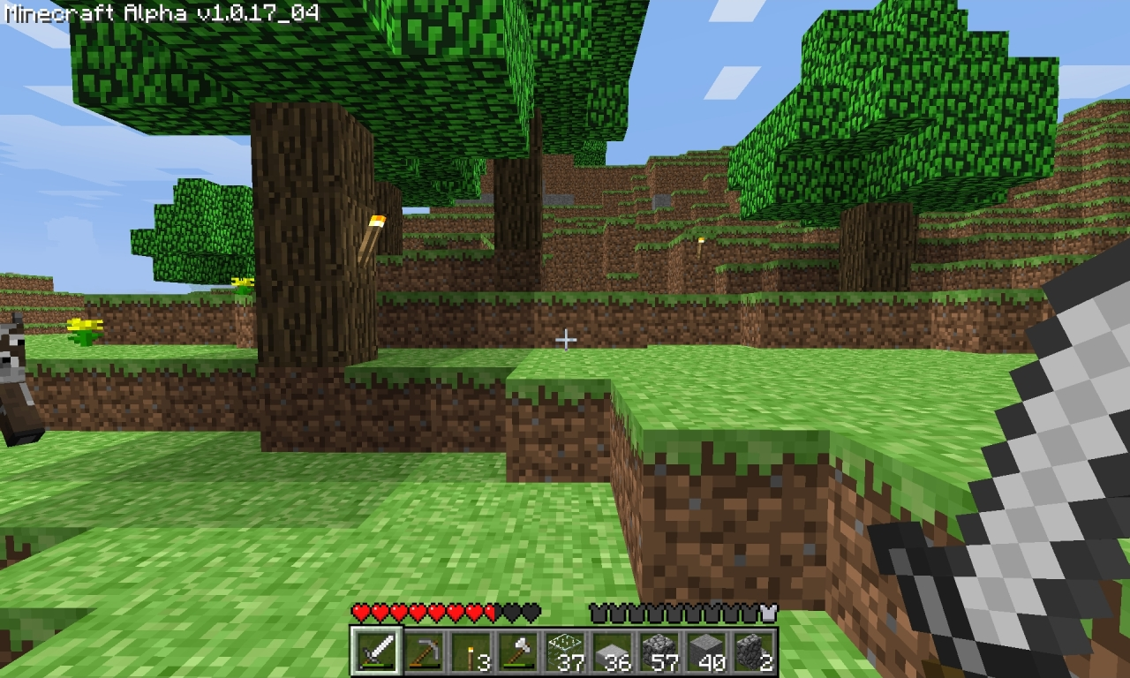
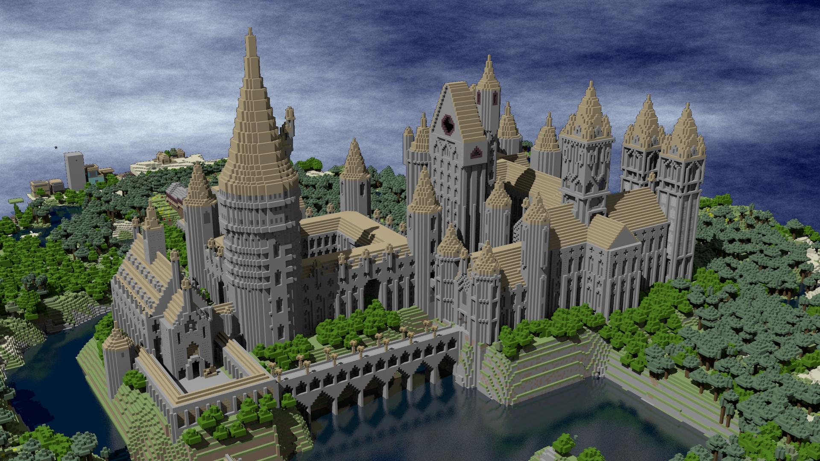
Gameplay loops
Specificity of “sandbox games”
Notes:
reward (proportional to the effort) : new functionalities, reinforcement of a character, or enrichment of the universe (more costumes, background informations, cutscenes)

Slide 20
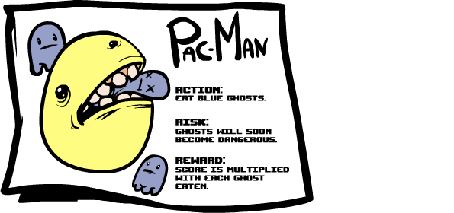
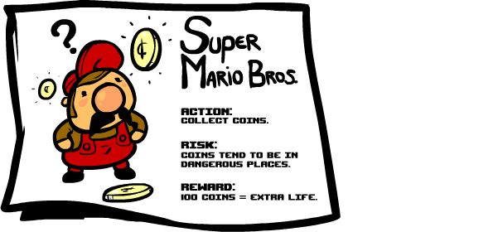
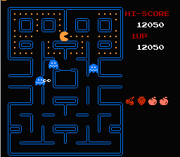
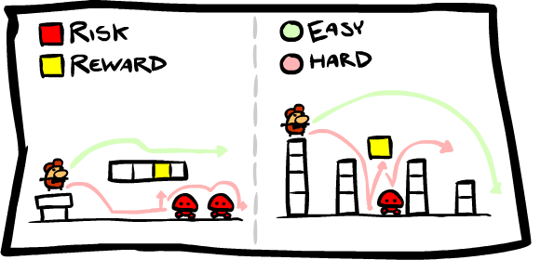
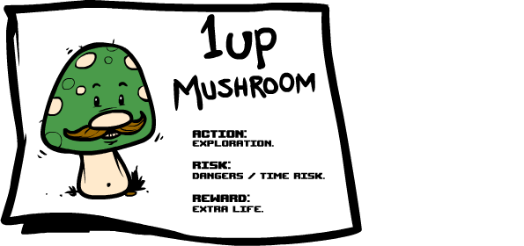
Risk and reward
Pacman (arcade), 1980
Credit: Edmund McMillen
Notes:
Pacman -> extra life every 10,000 coins

Slide 21
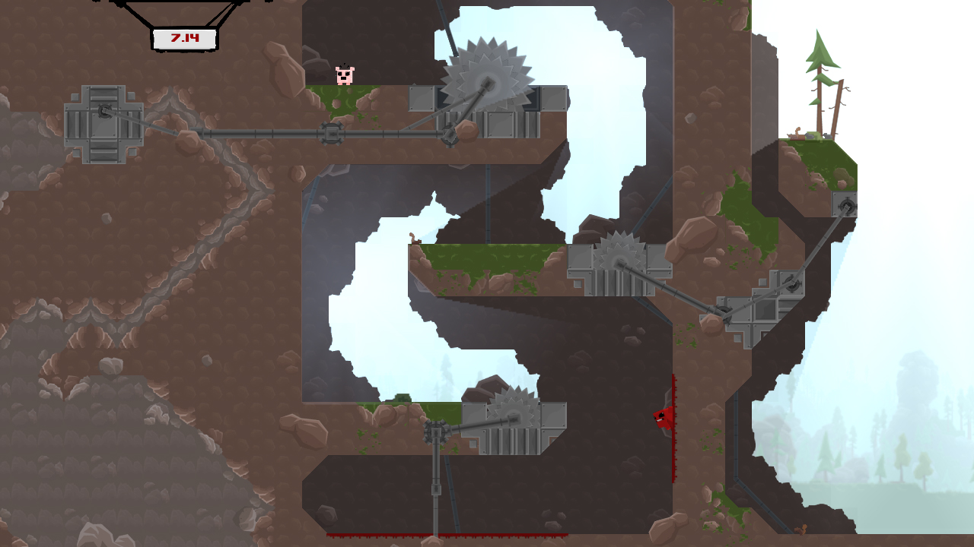
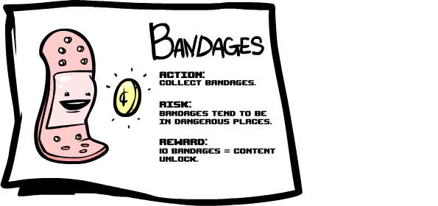
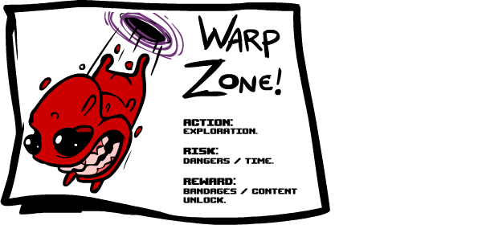
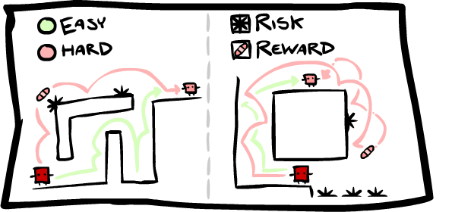
Risk and reward
Super Meat Boy (Xbox, Windows, Mac), 2010
Credit: Edmund McMillen
Notes:
Pacman -> extra life every 10,000 coins

Slide 22
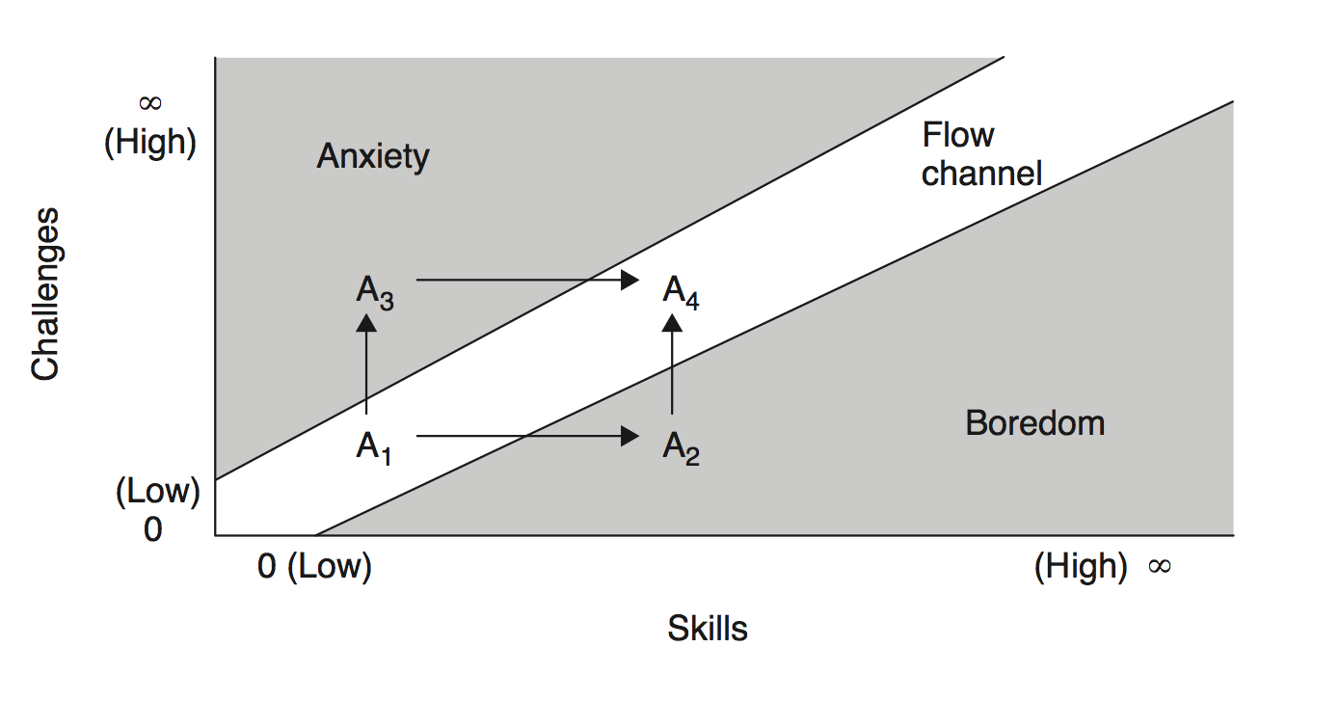
Managing difficulty
Credit: Jesse Schell

Slide 23
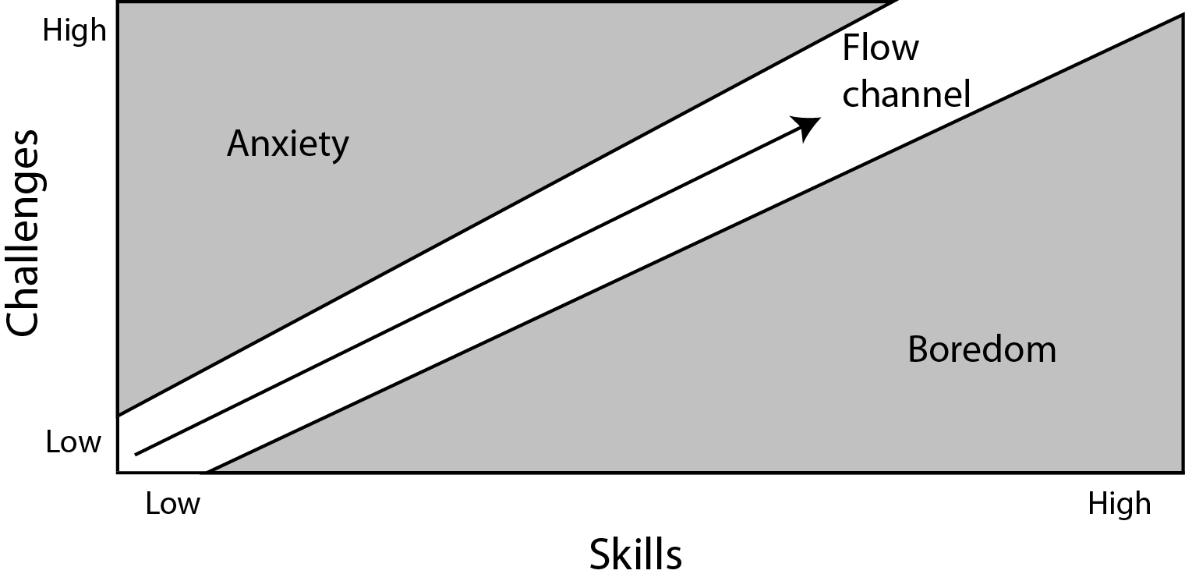
Managing difficulty
Credit: Jesse Schell

Slide 24
Managing difficulty
Credit: Jesse Schell

Slide 25
A cautionary tale
US
UK
Direct feedback!

Slide 26
Feedback
Used as a reward
Hierarchy in actions
Super Street Fighter IV (PS3, Xbox 360), 2010

Slide 27
Feedback: make your game juicy!
Credit: M. Jonasson, P. Purho

Slide 28
Bad feedback
Link: Faces of Evil (Philips CD-i), 1993

Slide 29
Great feedback
Fruit Ninja (mobile), 2010
Angry Birds (mobile), 2009

Slide 30
Great feedback
Rayman Legends (Wii U, PS3, Xbox 360, Windows), 2013

Slide 31
Tips for a successful game
Easy to understand rules/world
Polished core gameplay
Work on different level of achievements
Nice difficulty curve
Feedback

Slide 32
For going further
The Art of Game Design: A Book of Lenses, Jesse Schell
A Theory of Fun for Game Design, Raph Koster

Slide 33
Last words
The human brain is not so evolved
Play games!
Bad games can teach a lot too

Slide 34
What makes a game fun
Introduction to game design
Jean-Baptiste Boin

