Slide 1
Doing physics with Superman
Jean-Baptiste Boin

Slide 2
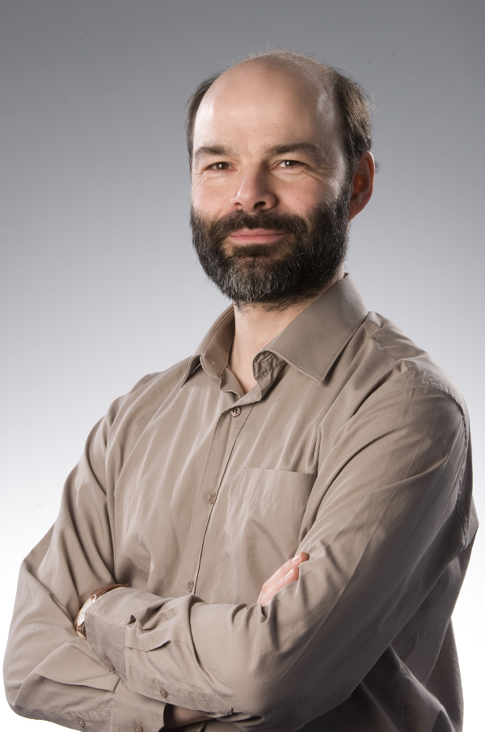
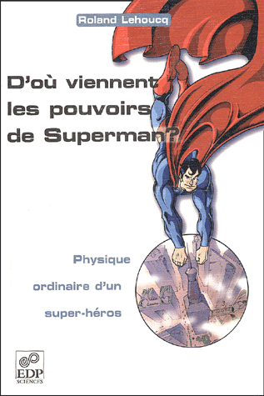
Hi everyone and welcome !
Talk inspired by Roland Lehoucq, a French astrophysicist (and a great teacher !)

Slide 3
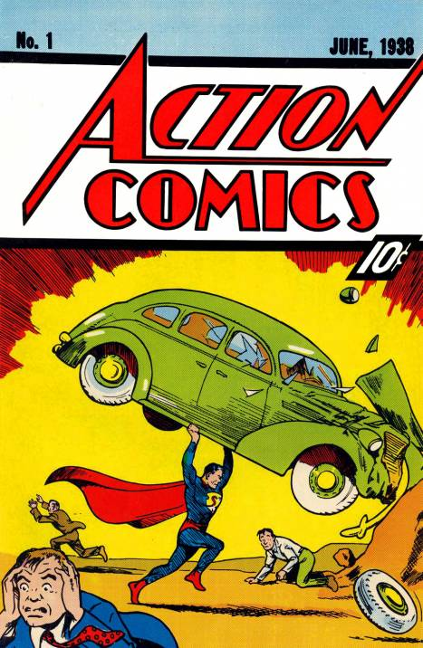
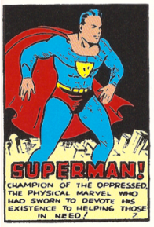
1938 – A new hero

Slide 4
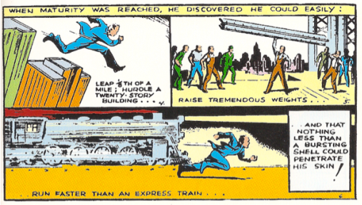
Impressive powers

Slide 5
Impressive powers

Slide 6
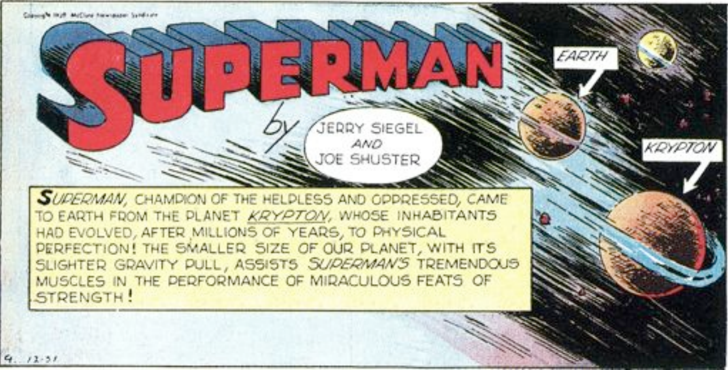
Super-strength : First argument

Slide 7
Super-strength : First argument
Notes:
Gravity moon -> 6 times less
Jump about 25 inches with a weight of 200 lbs

Slide 8
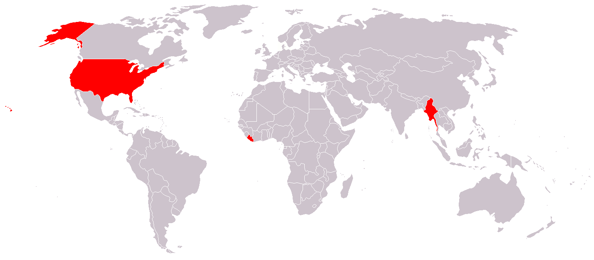
Quick aside…
Countries officially not using the metric system
Notes:
Burma, Liberia, United States

Slide 9
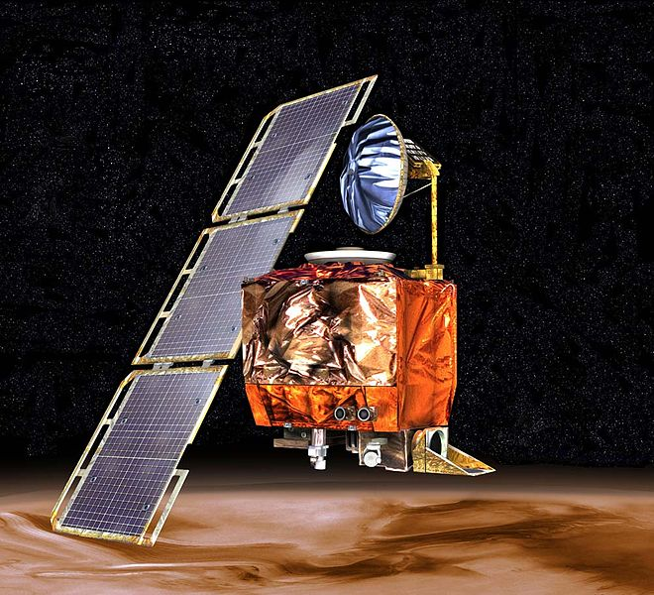
Quick aside…
Mars Climate Orbiter
« Specifically, the flight system software on the Mars Climate Orbiter was written to take thrust instructions using the metric unit newtons (N), while the software on the ground that generated those instructions used the Imperial measure pound-force (lbf). This error has since been known as the "metric mixup" and has been carefully avoided in all missions since by NASA. »

Slide 10
Super-strength : First argument
Notes:
Long jump : world record -> almost 9m (29 ft), a good athlete would do 7m
High jump : wr -> almost 2.5m (8 ft), a good athlete would do 2m

Slide 11
Super-strength : First argument
60 m
(200 ft)
200 m (660 ft)
g_{Krypton} ≈ 30 g_{Earth} !
Radius of Krypton ≈ 30 Radius of Earth
M_{Krypton} ≈ 30³ M_{Earth} = 27,000 M_{Earth}
Notes:
Long jump : world record -> almost 9m (29 ft), a good athlete would do 7m
High jump : wr -> almost 2.5m (8 ft), a good athlete would do 2m

Slide 12
Super-strength : First argument
M_{Earth} ≈ 6 x 10²⁴ kg
M_{Sun} ≈ 2 x 10³⁰ kg
M_{krypton} ≈ 2 x 10²⁹ kg

Slide 13
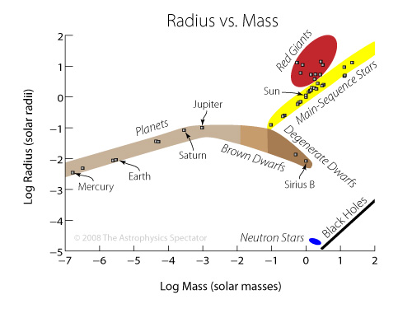
Super-strength : First argument
Krypton

Slide 14
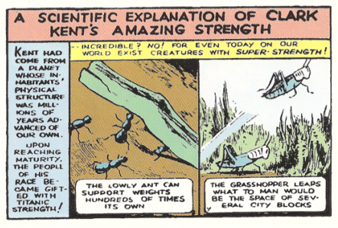
Super-strength : Second argument
Weight : 10 mg Can carry up to 1 g
X 100 !

Slide 15
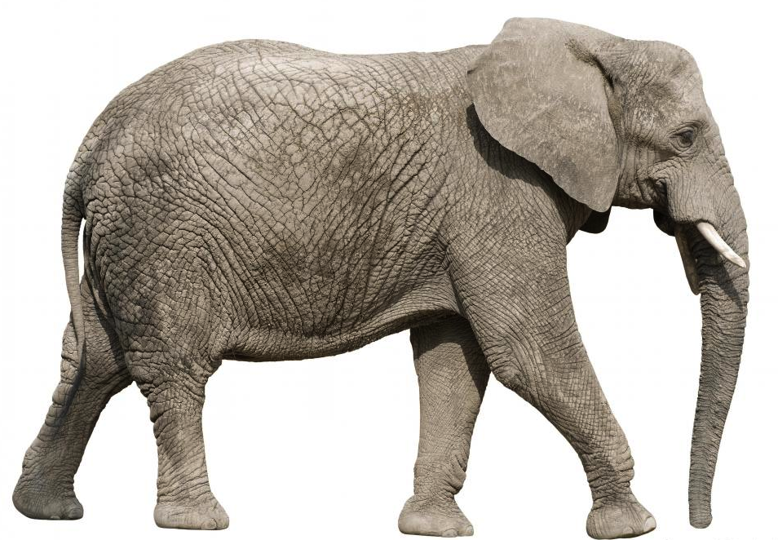
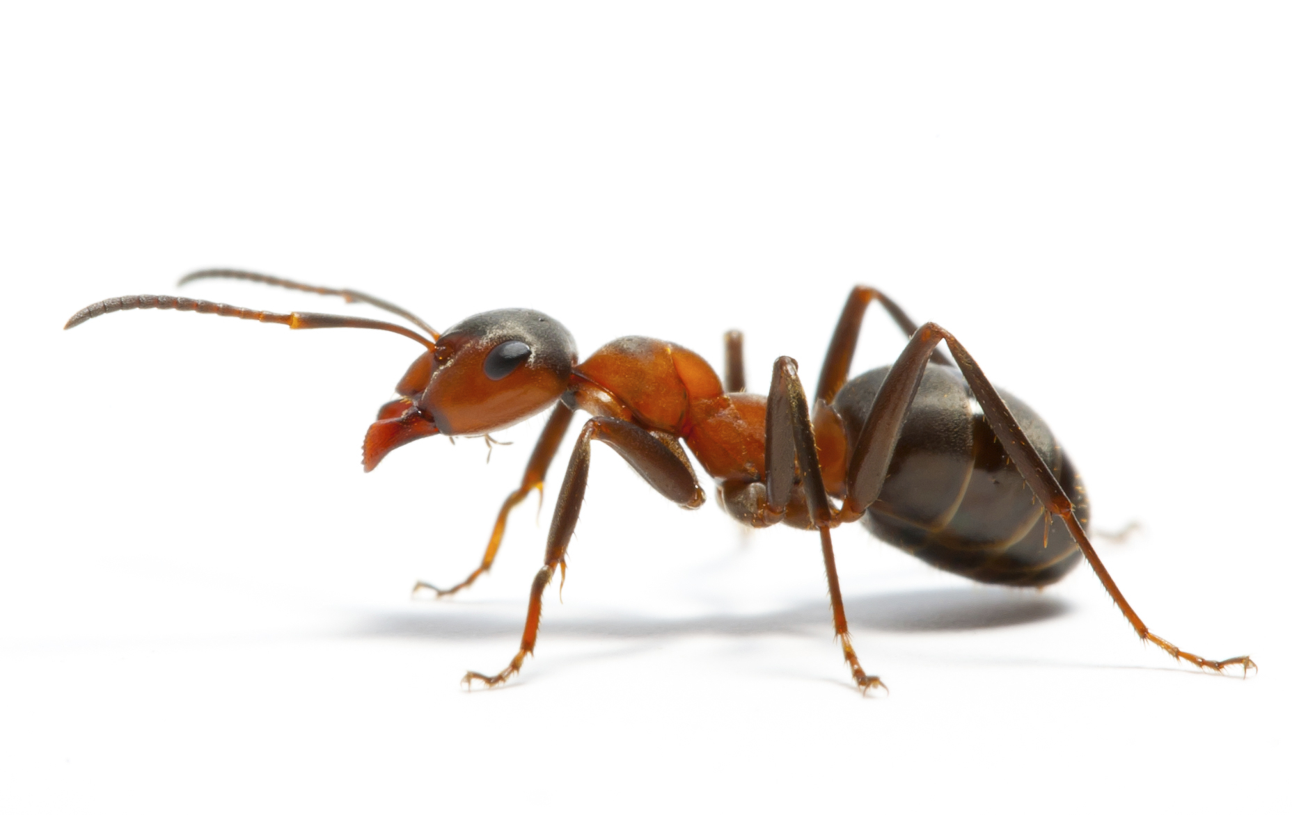
Super-strength : Second argument
Notes:
Weight elephant : 6500 kg = 14,000 lbs

Slide 16
Super-strength : Second argument
Can an elephant carry 100 elephants ?
Notes:
Weight elephant : 6500 kg = 14,000 lbs

Slide 17
The square-cube law
1 cm
2 cm
Area ?
Volume ?

Slide 18
The square-cube law
1 cm
2 cm
Area of a face : 1 cm²
Volume : 1 cm³
Area of a face : 4 cm²
Volume : 8 cm³

Slide 19
The square-cube law
1 cm
2 cm
Area of a face : 1 cm²
Volume : 1 cm³
Area of a face : 4 cm²
Volume : 8 cm³
X 4
X 8

Slide 20
The square-cube law
1 cm
L cm
Area of a face : 1 cm²
Volume : 1 cm³
Area of a face : L² cm²
Volume : L³ cm³
x L²
x L³

Slide 21
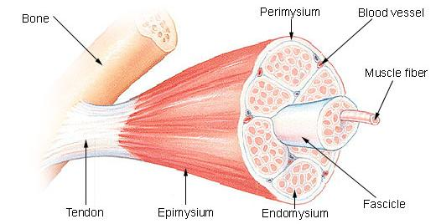
The square-cube law - strength
Power developed by a muscle : proportional to
a surface (L²)
Mass : proportional to a volume (L³)

Slide 22
The square-cube law - strength
M₁
M₂
M₂/M₁ = (L₂/L₁)³ ⇒ L₂/L₁ = (M₂/M₁)^{1/3}
P₂/P₁ = (L₂/L₁)² = (M₂/M₁)^{2/3}
Strength is proportional to mass^{2/3} !

Slide 23
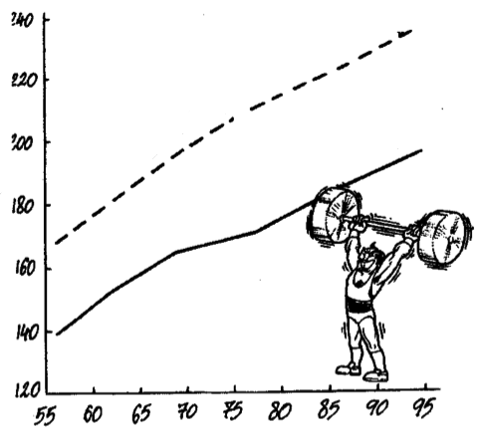
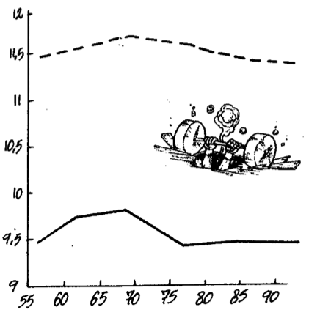
The square-cube law - strength
Clean-and-jerk
Snatch
Mass lifted (kg)
Mass lifted / Mass of athlete^{2/3}
Mass of the athlete (kg)
Mass of the athlete (kg)

Slide 24
The square-cube law - strength
Man (75 kg) can lift ≈ his weight
Ant ?
An ant is not that impressive finally…
Mlifted_{ant} = Mlifted_{man} (M_{ant}/M_{man})^{2/3}
≈ 1.9 g

Slide 25
Superman’s muscles
Adapted to Krypton’s gravity
Power multiplied by 30
Man : 120 W (watts) per kg of muscle
Superman : 3600 W per kg of muscle
10 m (33 ft)

Slide 26
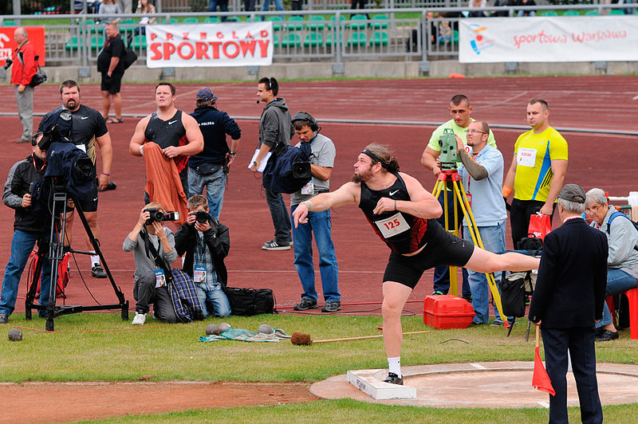
Superman’s muscles
Shot put - world record : 22 m (72 ft) for a weight of 7.26 kg (16 lbs)
For 10 m : 360 Joules in 0.25s = 1440 W
12 kg of muscles used
A car (1000 kg = 2200 lbs) is 137 times heavier
Power : 43200 W
55 kg (120 lbs) of muscles used !
Notes:
Independent of the mass

Slide 27
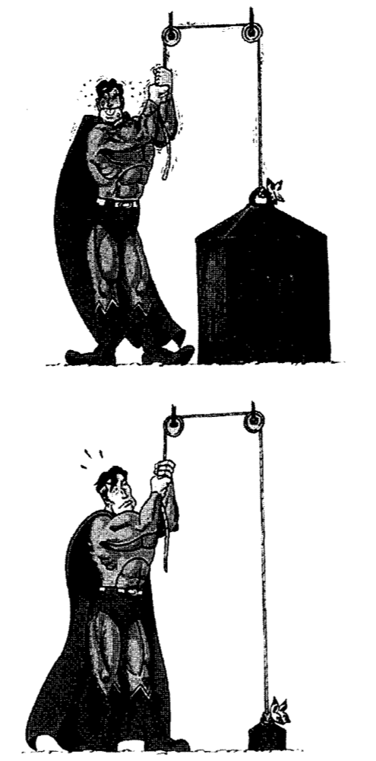
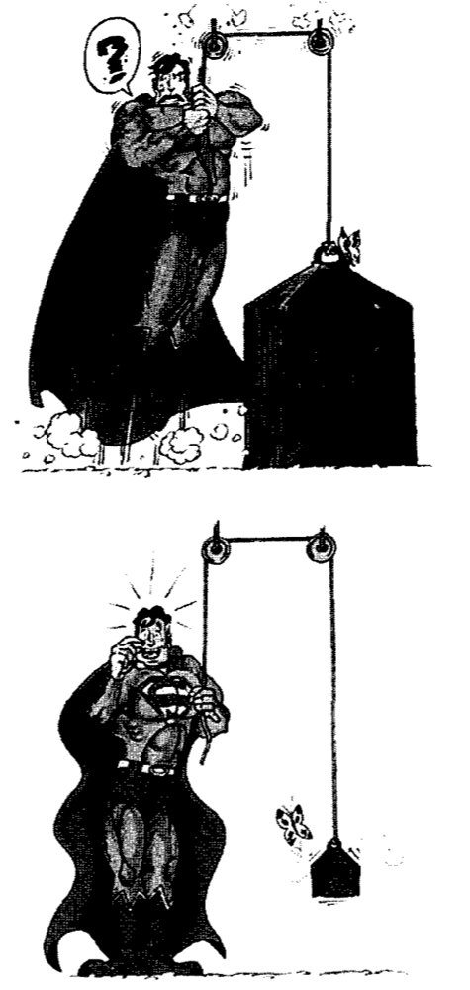
Strength isn’t all…
200T
200T

Slide 28
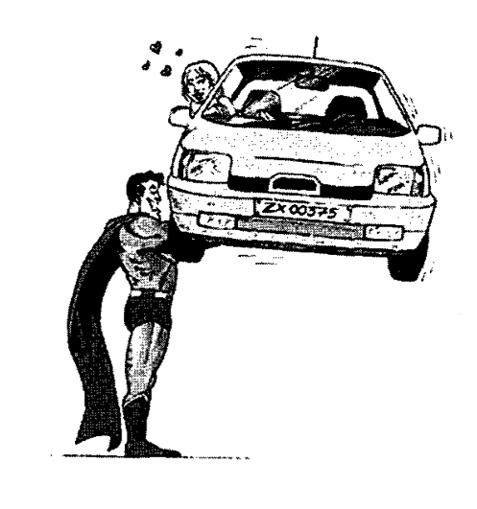
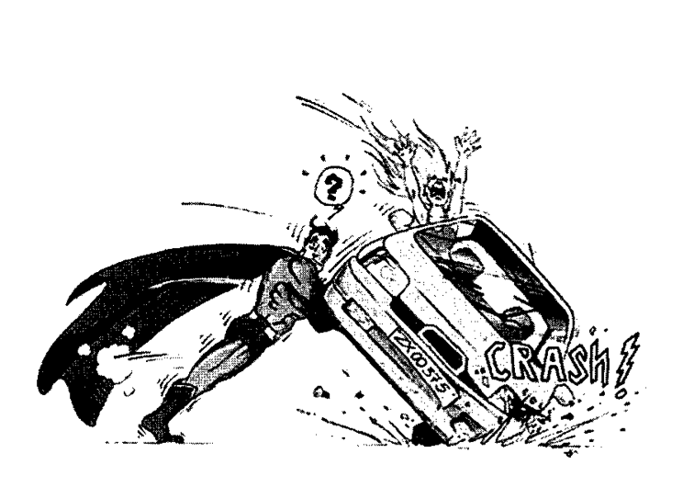
Strength isn’t all…

Slide 29
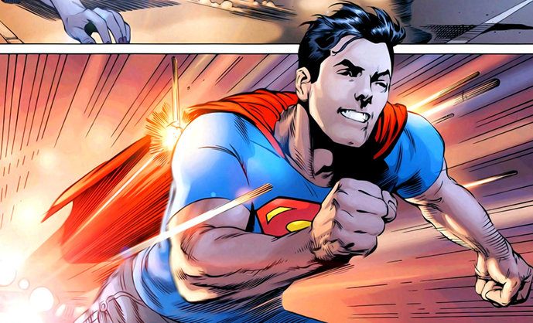
Run, Superman, run !
Speed : 30 times faster than a human
300 m/s (1080 km/h = 670 mile/h) = bullet
Problem : friction, proportional to v²
Max speed : only 3 times faster than a human

Slide 30
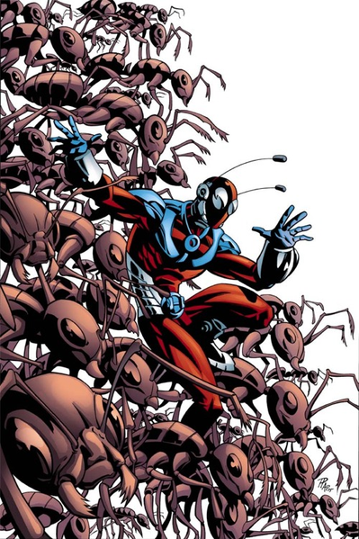
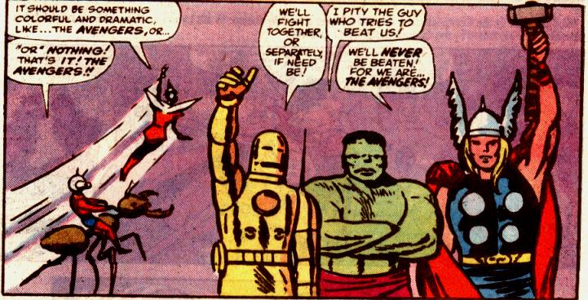
Another superhero : (Gi)Ant-man !

Slide 31
Another superhero : Ant-man !

Slide 32
Another superhero : Ant-man !

Slide 33
The square-cube law - stress
Stress at the bottom of the cube : s = F/A = Mg/A
Multiplied by L
Much higher for larger structures !

Slide 34
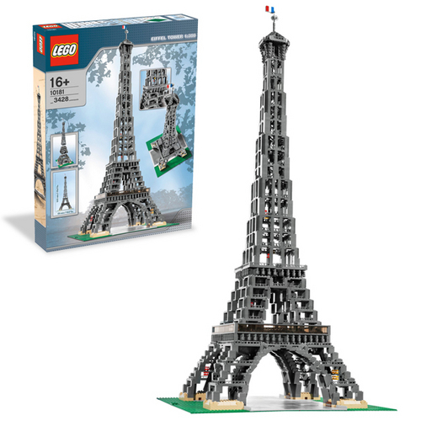
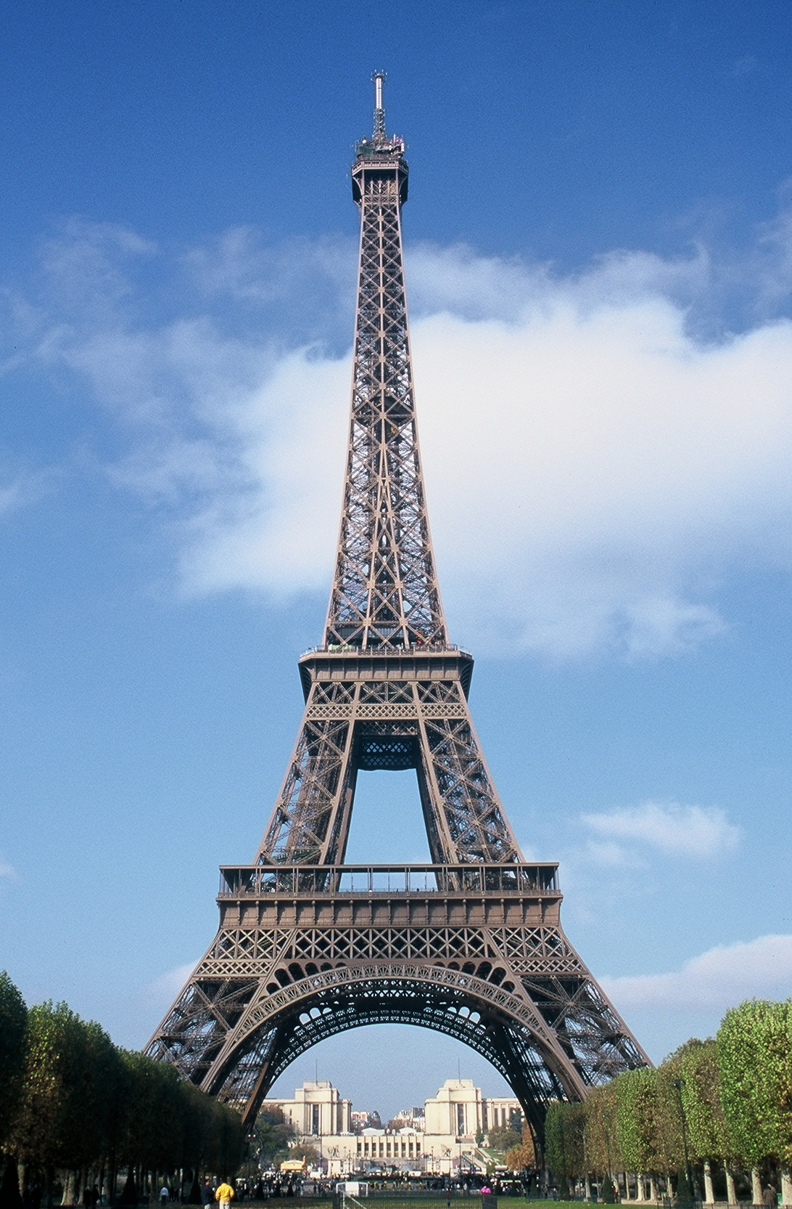
The square-cube law - stress

Slide 35
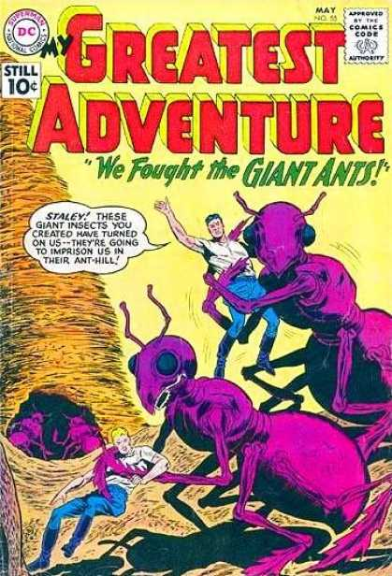
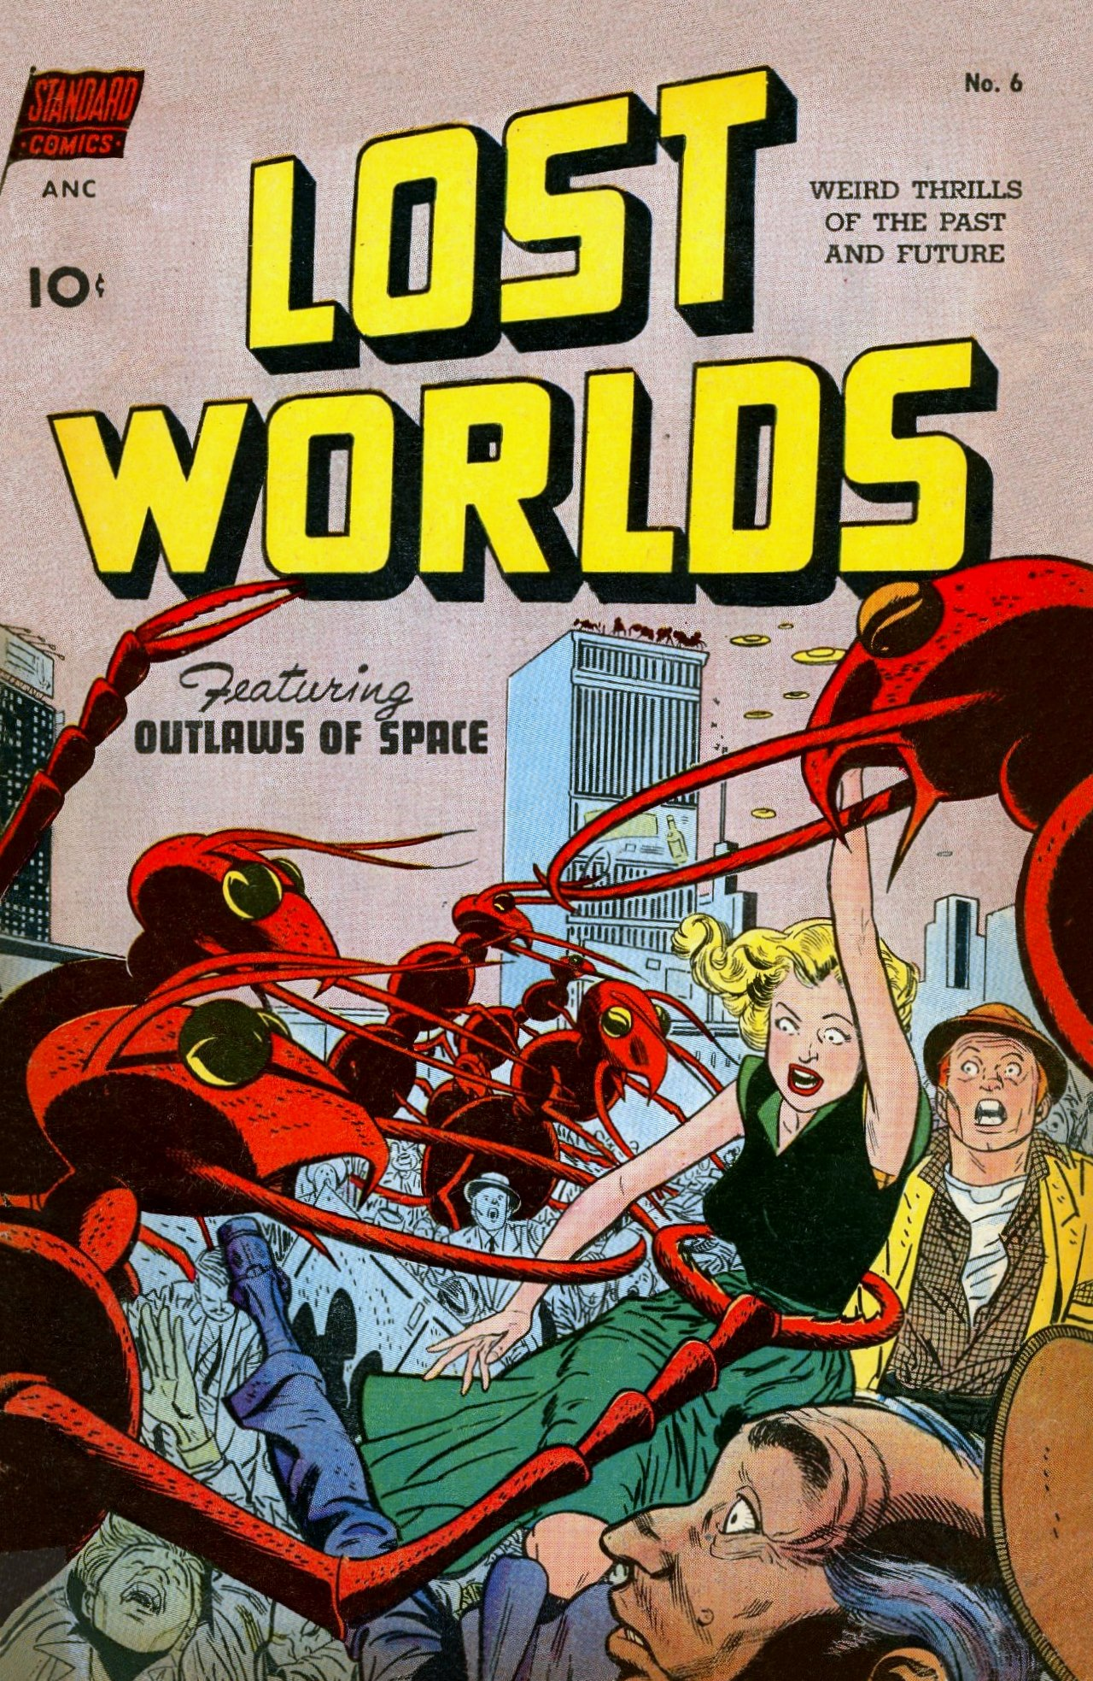
The square-cube law - stress
Notes:
Kills whale, but also Godzilla and King Kong !

Slide 36
The square-cube law - stress

Slide 37
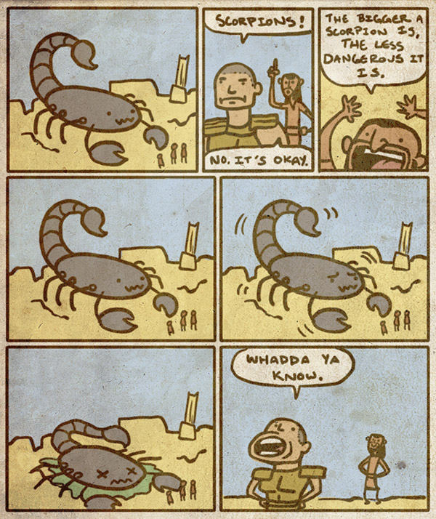
The square-cube law - stress
Bad news for Giant-man !
(but also for King Kong and Godzilla)
Notes:
Kills whale

Slide 38
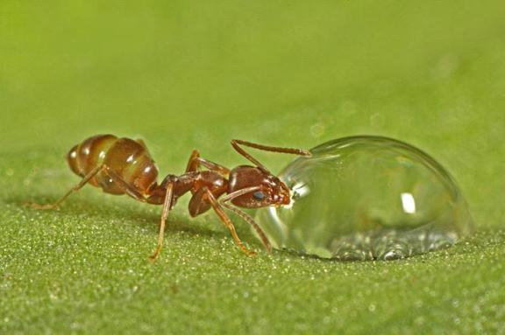
Ant-man’s daily problems
Notes:
Kills whale

Slide 39
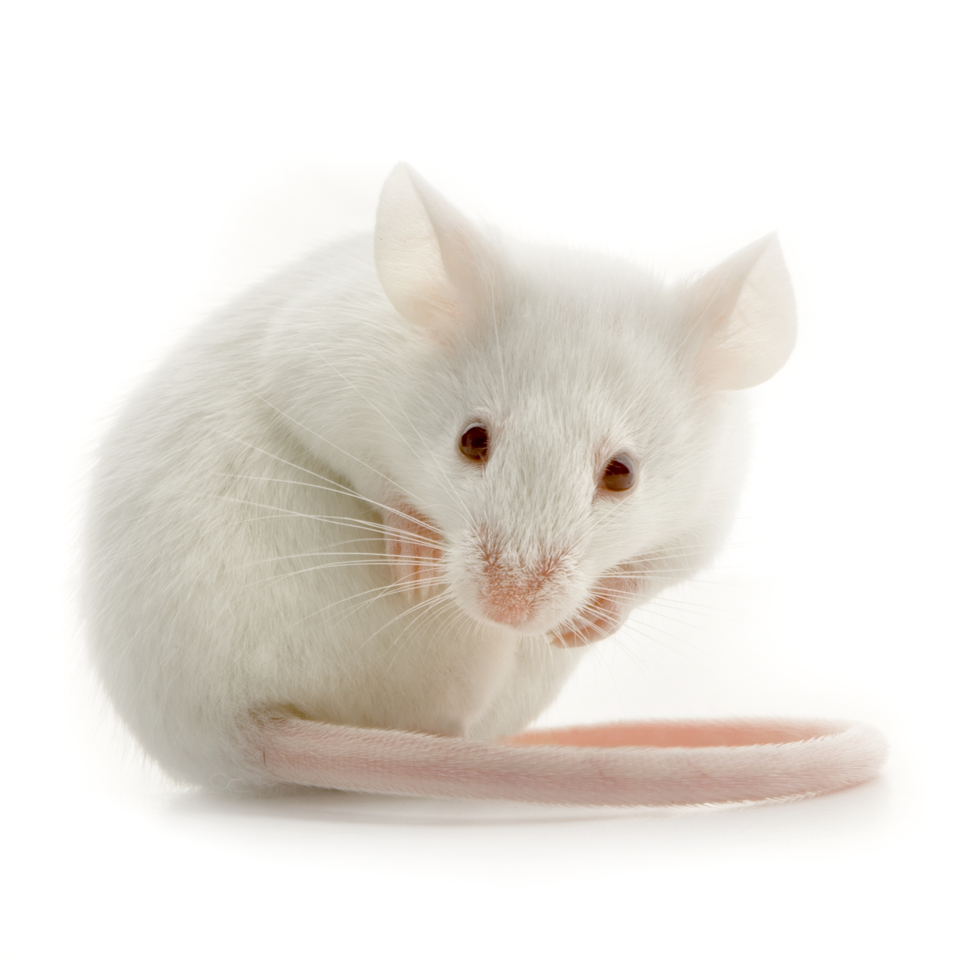
The square-cube law - temperature
Energy (heat) produced : proportional to a volume
Energy (heat) dissipated : proportional to a surface
Notes:
Mouse (30g) : eats about 1/3 of its weight per day
Elephant : a few tons

Slide 40
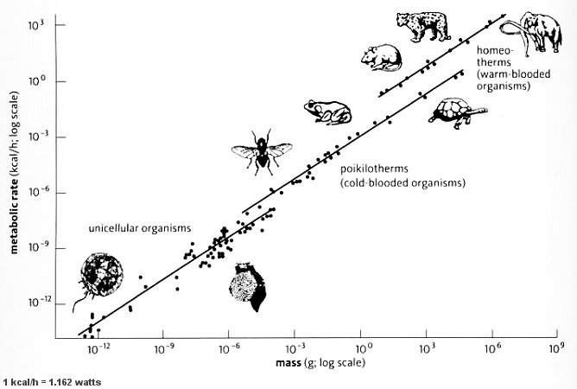
1932 : Kleiber’s law
Superman
Slope = 3/4
Power proportional to m^{3/4}
Power per kg proportional to 1/m^{1/4}
Notes:
Reserves : 7 millions of Joules (1700 kcal) per kg
Mouse : 1 week
Elephant : a few months
Man : 60 days (hunger strike)
Superman : 50,000 J = 40,000 kcal/h

Slide 41
A fast beating heart ?
Blood brings nutrients and oxygen to organs
Power is proportional to blood flow
Blood flow heart frequency x
volume of blood
f_{heart} proportional to m^{1/4}
Life span also proportional to m^{1/4} !
Notes:
Superman : 50,000 J = 40,000 kcal/h

Slide 42
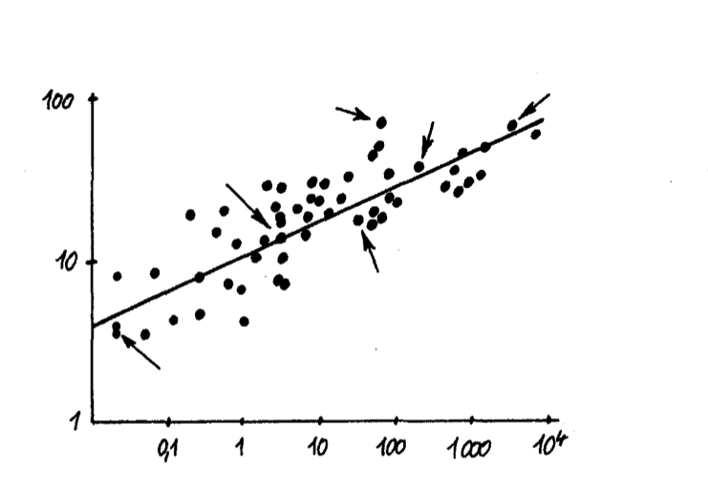
A fast beating heart ?
f_{heart} proportional to m^{1/4}
Life span also proportional to m^{1/4} !
Life span (y)
gorilla
elephant
man
fox
Not a super-heart but a super-blood !
goat
mouse
Mass (kg)
Notes:
Man 30yo
→ 1800 beats per minute !!

Slide 43
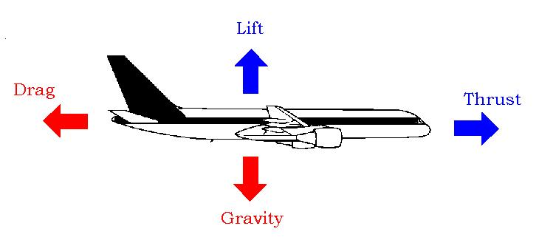
It’s a bird ! It’s a plane !
Necessary speed : 70 km/h (100 mph)
Power needed to overcome drag : 2,000,000 W

Slide 44
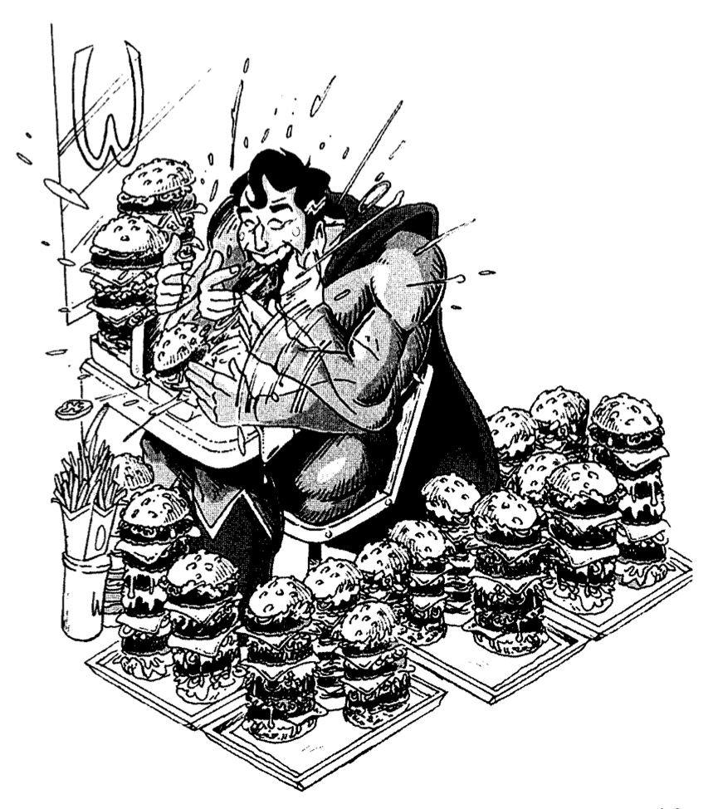
Food for thought
480 kcal per second
Efficiency of 25%
… equivalent of 2 lunches consumed per second

Slide 45
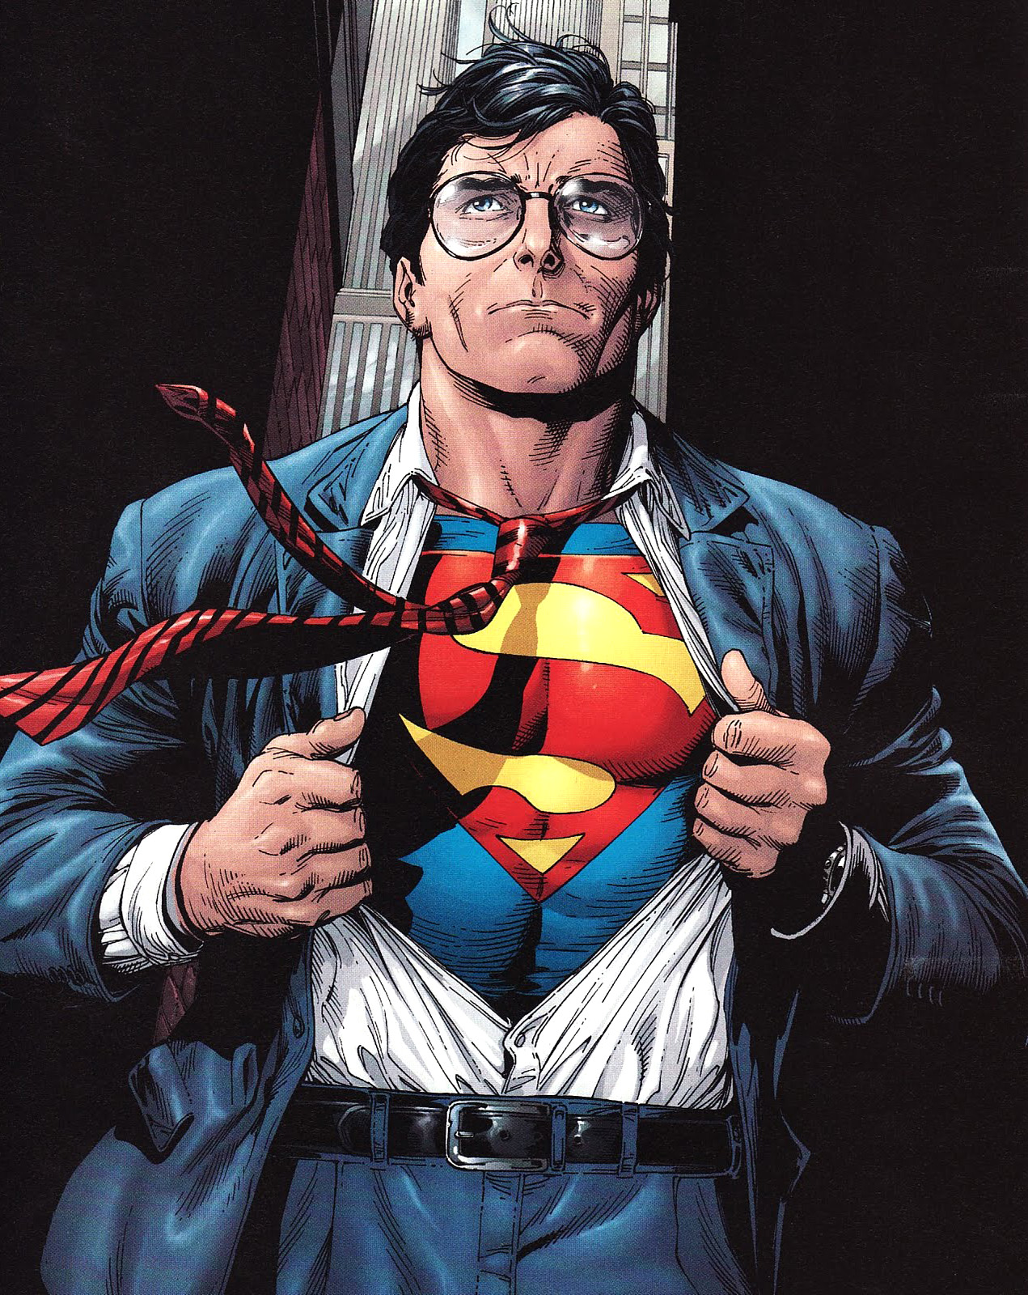
Other (cool?) superpowers
Telescopic vision
Night/infrared vision
Heat vision
X-ray vision
Super-hearing
Freeze breath
…

Slide 46
Thanks ! Questions ?
Jean-Baptiste Boin

